Slide 1
The “No Code” Data Science Experience
Introduction to Data Analytics and Visualisation - Tableau

Slide 2
Study Units
Time frame and Deliverables
Study Unit | Topic | Timme
1 |  | 4th Feb
2 |  | 6th Feb
3 |  | 18th Feb
4 |  | 25th Feb
5 |  | 4th Mar
6 |  | 11th Mar

Slide 3
Learning Objectives of ANL201
By the end of this Course
Understand concepts of Business Performance, Measurement, Balanced Scorecard Model and Data Visualization
Compare stages of Data Visualization Process
Data Visualization Components
Design Principles of a Business Performance Dashboard
Appropriateness of Data Visualization techniques based on available data
Appropriates of Business Performance Measure against Business Strategy of Organization
Required Textbooks:
Yau, N,.(2013). Data Points: Visualization that Means Something
Murray, D. G. (2013). Tableau Your Data

Slide 4
Installation of Tableau Desktop and Prep
For January 2021 semester, Tableau Desktop 2020.4 will be used for teaching, assessments, and exam
To download Tableau, visit the Tableau for Teaching landing page at https://www.tableau.com/tft/activation
Click on “Download Tableau Desktop”
Fill in your SUSS email address in the “Business E-mail” field, and click on “Download Free Trial”
Go back to the landing page, and click on “Download Tableau Prep”
Activate your product key
Notes:
To be updated

Slide 5
Introductions
Name
Profession/ What you do/ What you like
Do you currently use visualisation?
What would be one thing you want to take away from this class?

Slide 6

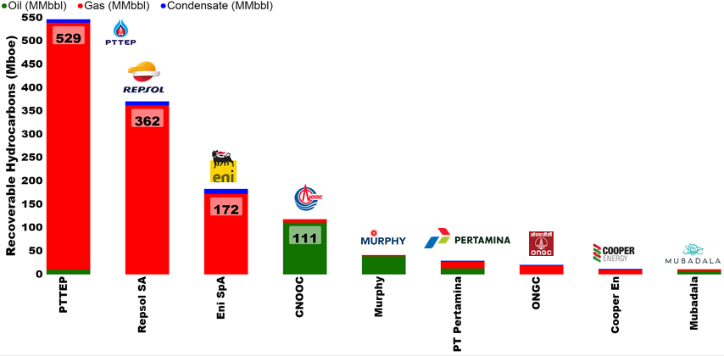
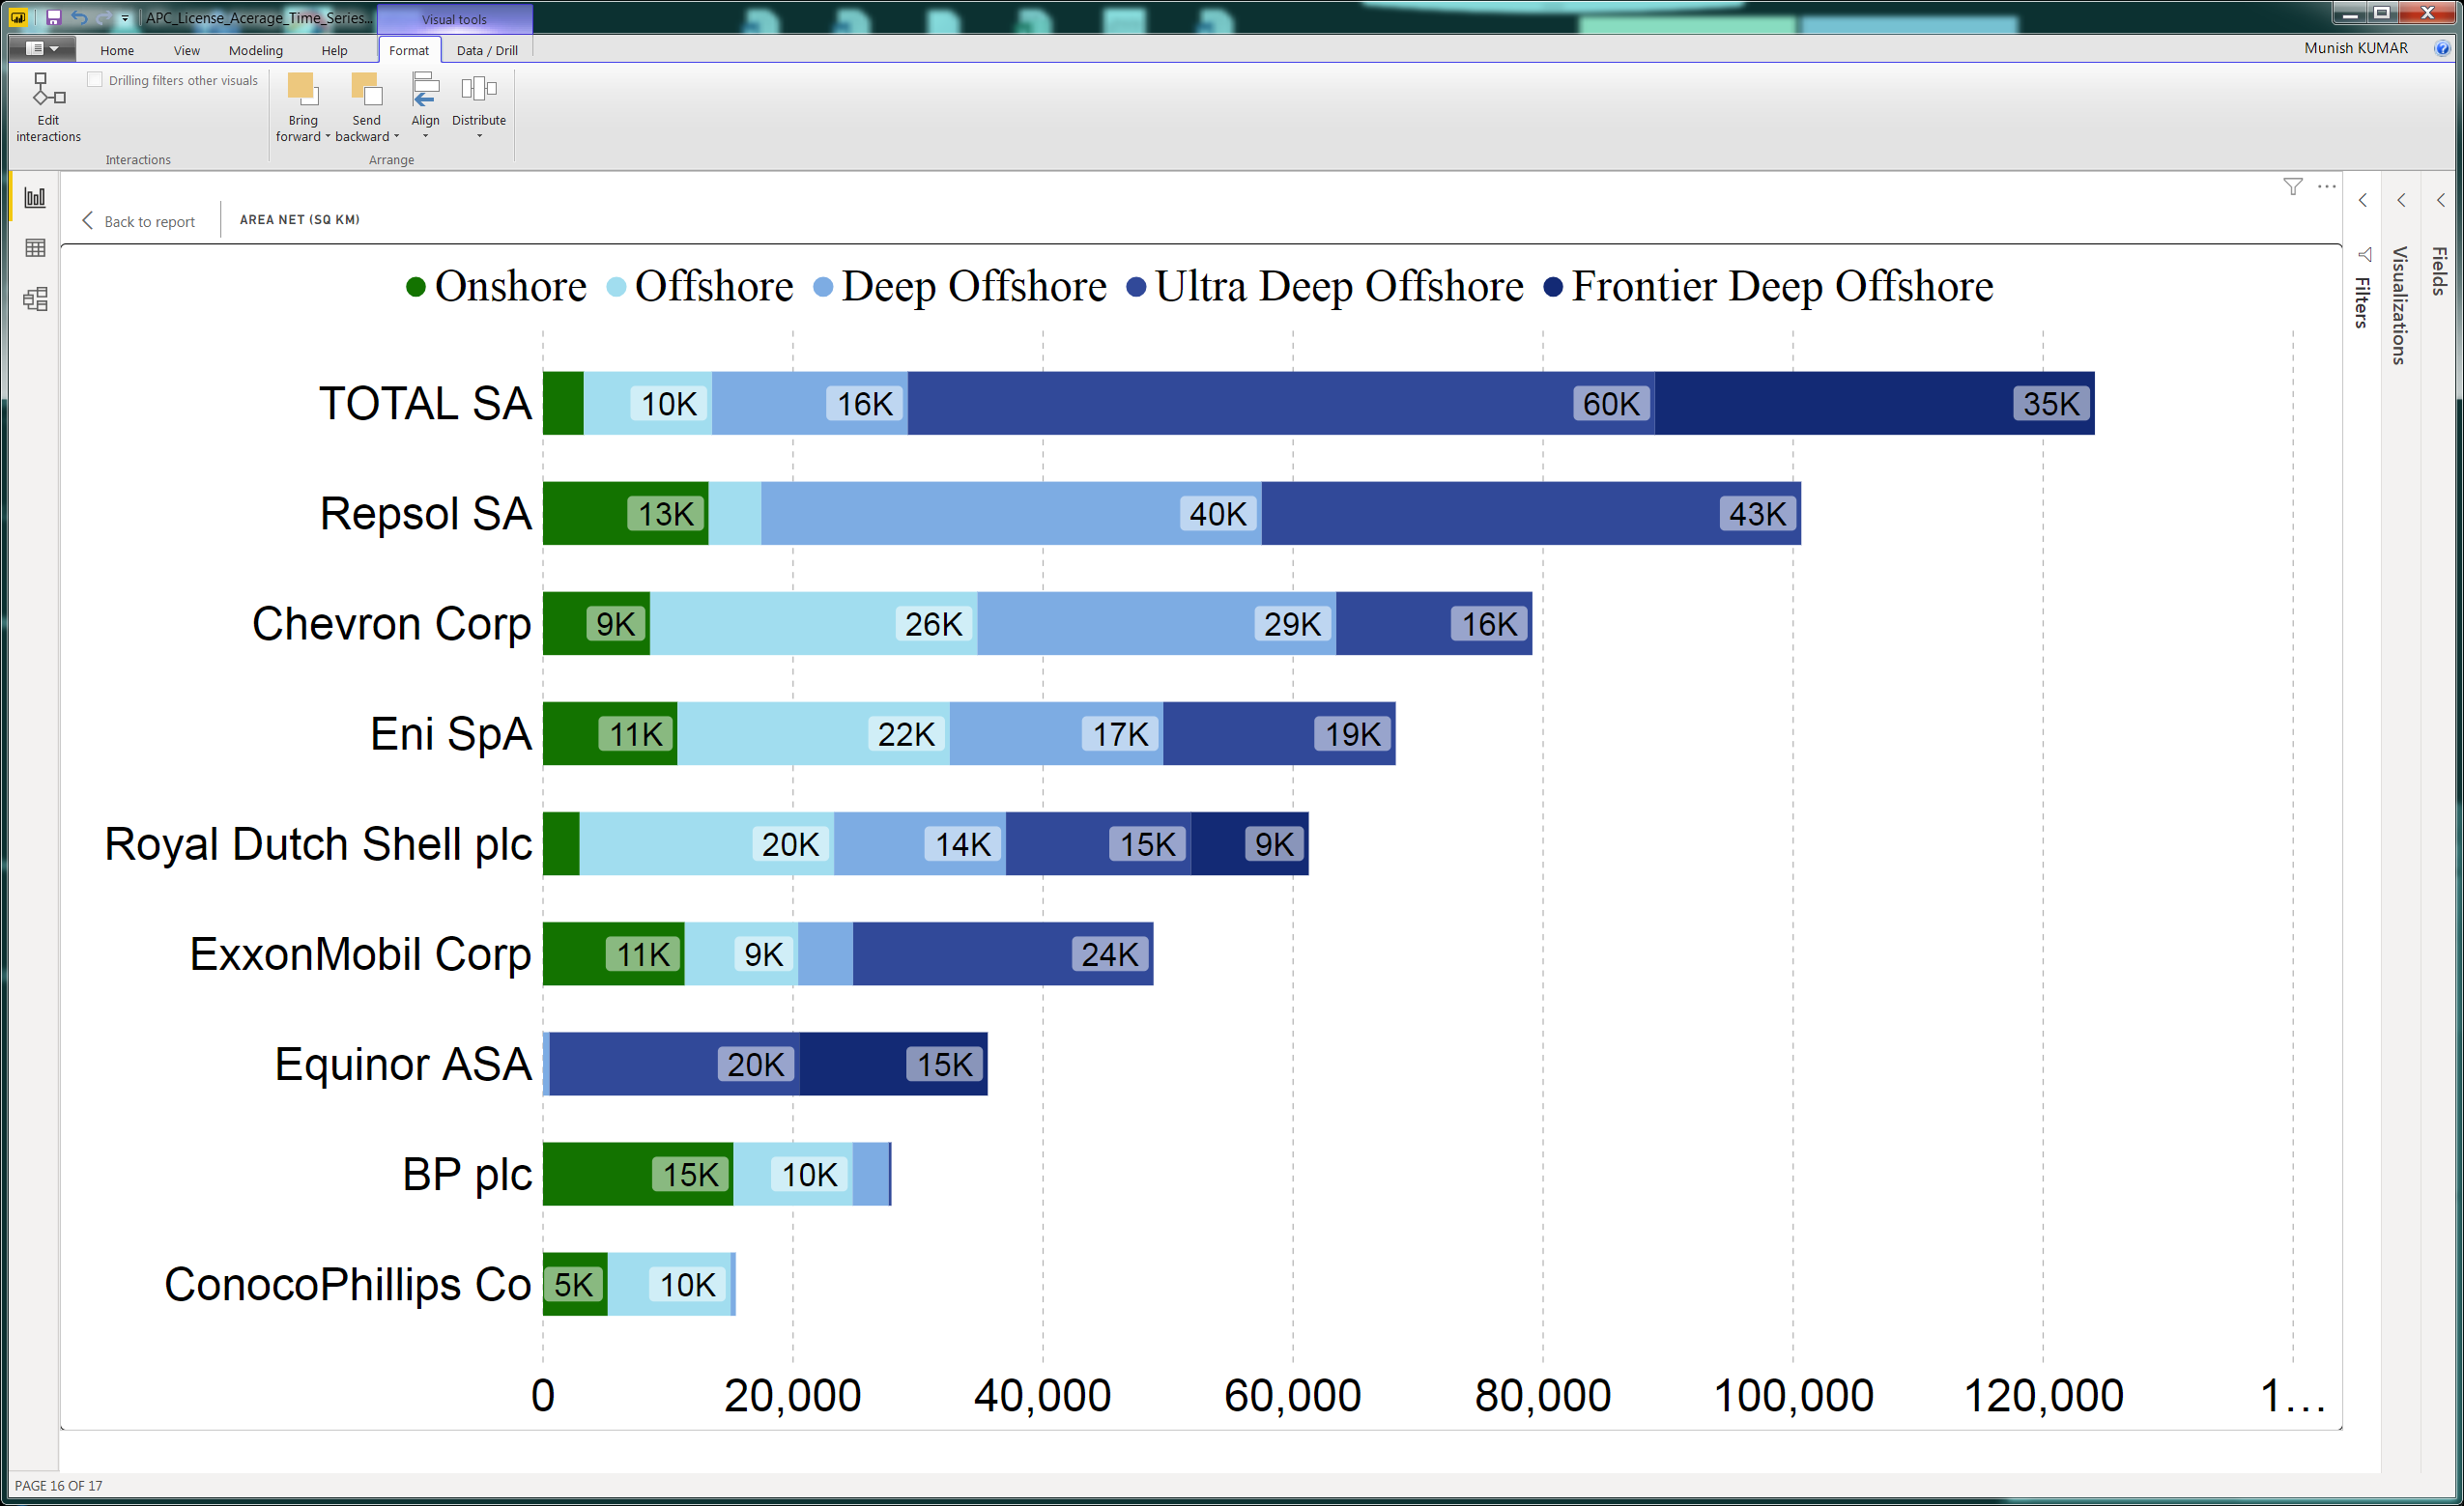
SUSS Associate faculty: Dr Munish Kumar
No-Course Code
Academic Qualification:
Ph.D. Physics, Australian National University
Courses taught at SUSS:
ANL201 Data Visualisation for Business
ANL252 Python for Business
ANL488 Applied Project for Business Analystics
Active Area of Work/ Projects:
Energy Auditing (Reserves), Application of Data and visualisation in Oil and Gas, Energy, Renewables Sector
Tools of the trade: Python, Tableau, Power BI, Excel,

Slide 7
Part 1 - Understanding Data

Slide 8
Understanding Data
The four measurement levels of data quality attribute
Nominal measurements measure items based on their labels or categories or other qualitative classification the items belong to with no implied order
Ordinal measurements arise from the operation of rank ordering
Interval measurements allow us to measure the degree of difference between items, but not the ratio between them
Ratio measurements estimate the ratio between a magnitude of a continuous quantity and a unit magnitude of the same kind

Slide 9




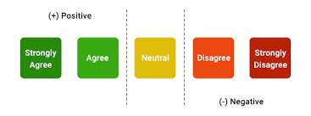



Understanding Types of Data
Types of Data
Qualitative
Quantitative
Arithmetic
Measuring the data
Nominal
Ordinal
Interval
Ratio
○K
Unordered
Ordered Words
Discrete
Continuous
No True Zero

Slide 10
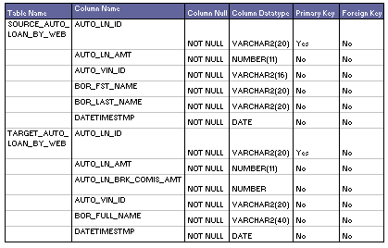
Understanding Data
Metadata
Metadata is structured information that explain, describe or locate the original (i.e. also known as primary data), otherwise make the using of original data more efficient
Source: http://learndatamodeling.com/wp-content/uploads/2015/10/tmeta.gif

Slide 11
Part 2 - An Introduction to Data Visualisation

Slide 12
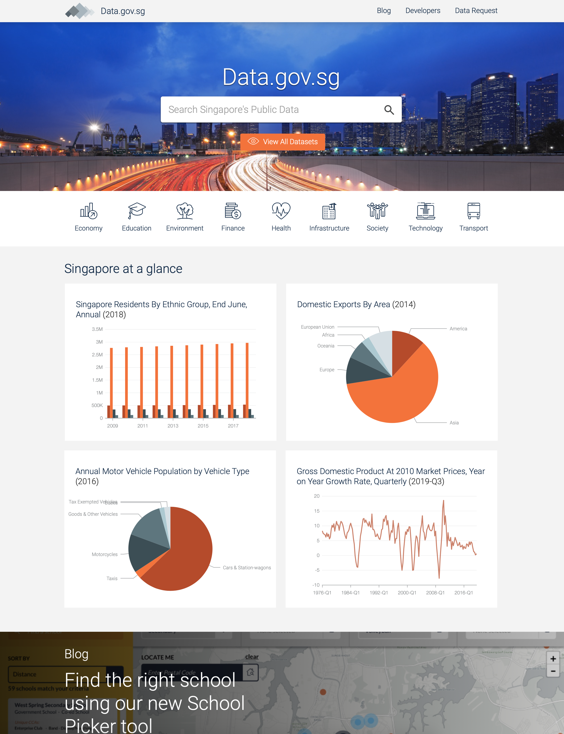
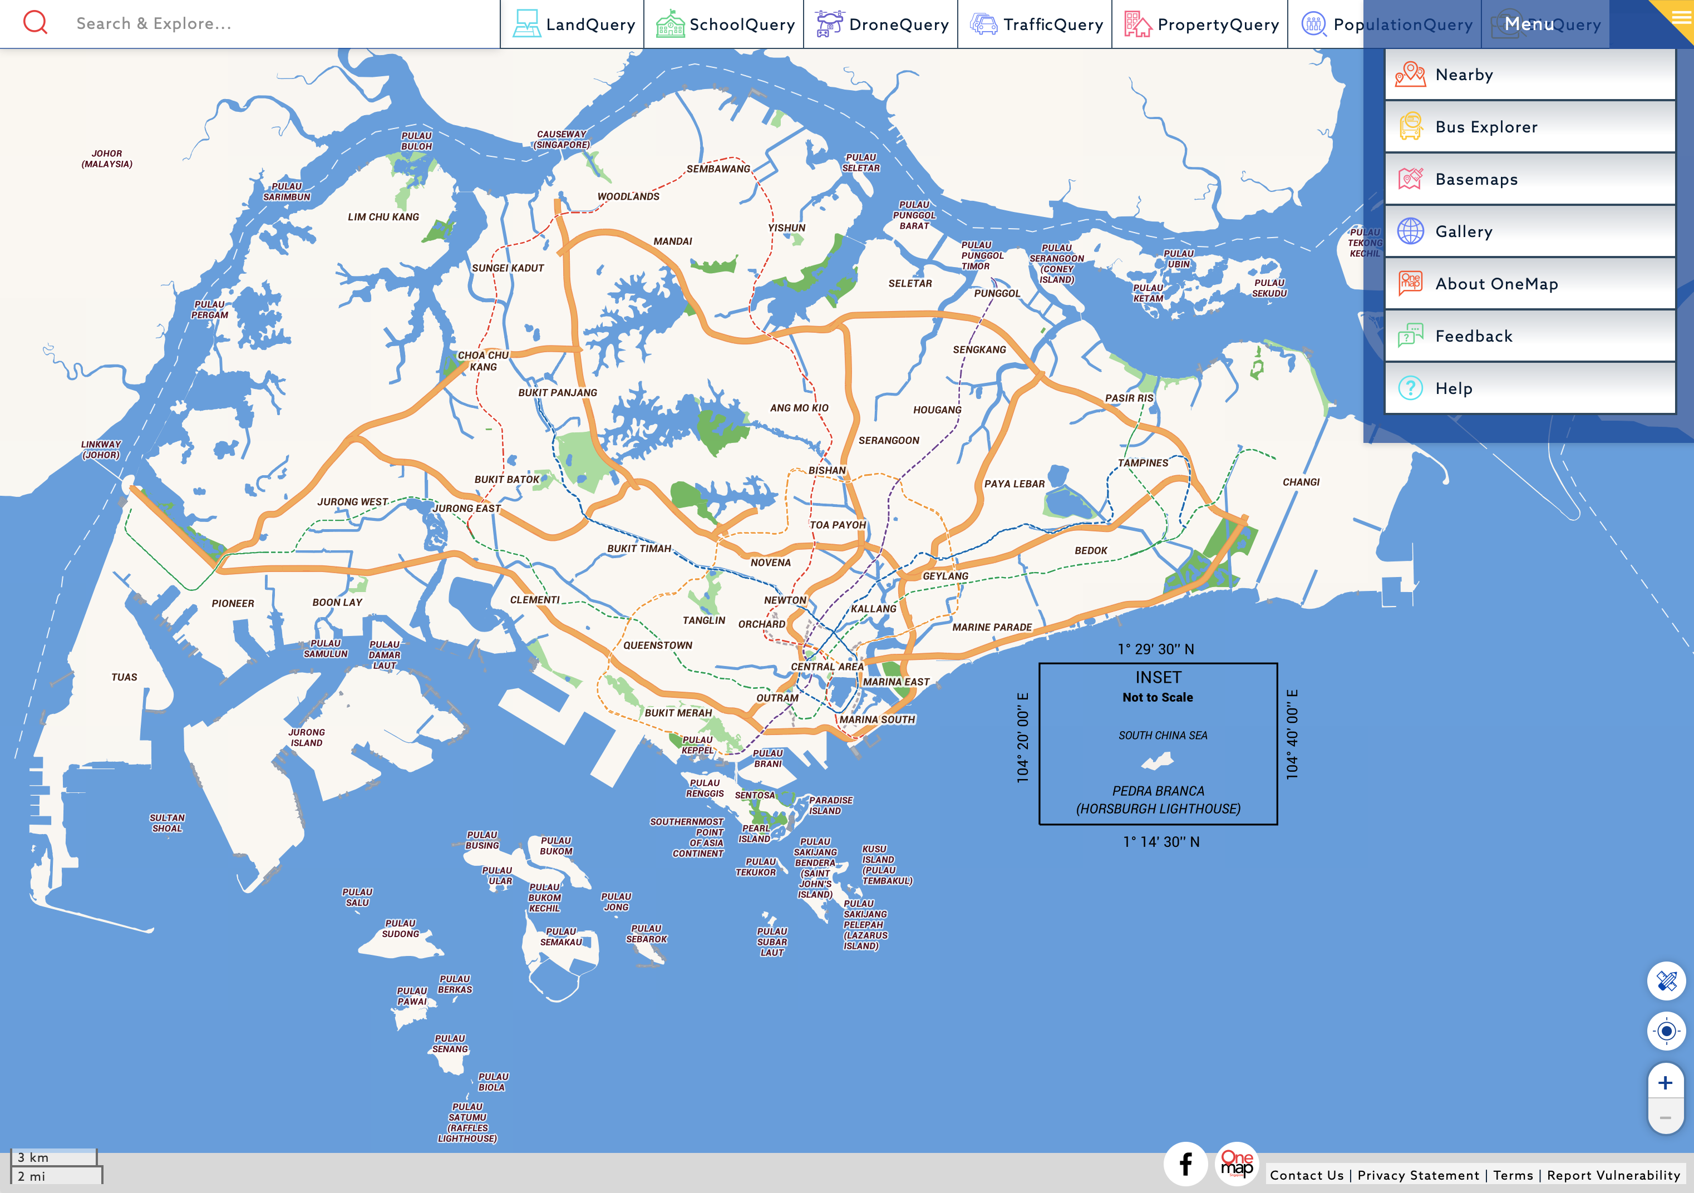
Data Visualisation
Overwhelming amount of data available today
A colour map is essentially millions of data points/ measurements. Overwhelming in an excel sheet, but easy to see on a map

Slide 13
Data Visualisation
The four stages of the data visualisation process [Ware (2013)]
Data Collection and Storage: the collection and storage of data
Data Pre-processing: the pre-processing of data to transform it into something one can understand
Graphics Engine: the display hardware and the graphics algorithms to produce data visualisation on screen
Human Visual and Cognitive Processing: human perceptual and cognitive systems that are involved in interpreting the visualised data

Slide 14
Data Visualisation
Benefits
Provides us the ability to comprehend huge amounts of data
Allows the perception of emergent properties that are not anticipated (e.g. red for danger)
Often enable problems with data to become immediately apparent (missing data or blank (pixels))
Facilitates the understanding of both large-scale and small-scale features of the data
Facilitates hypothesis formation

Slide 15
Part 3 – Tableau as a Tool for Business Analytics & Visualisation

Slide 16
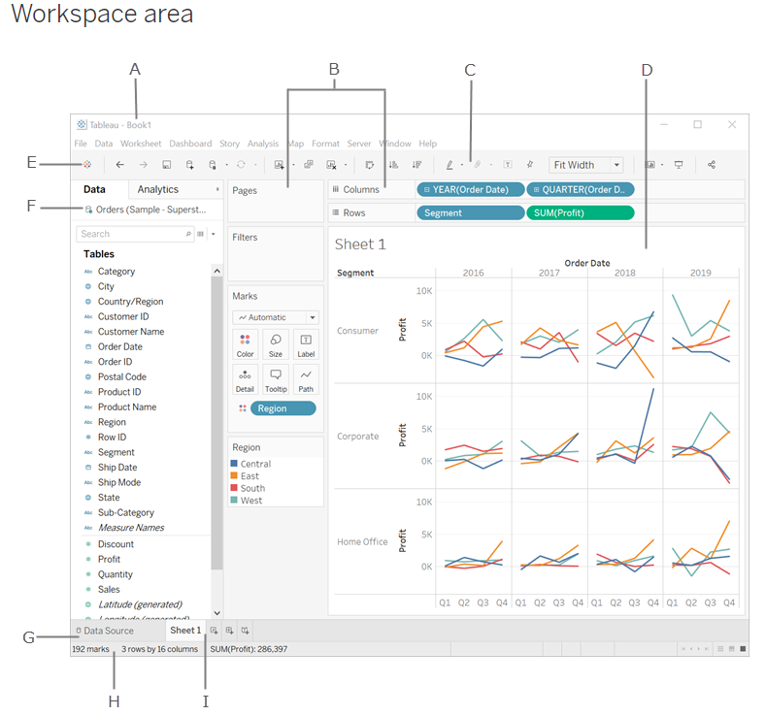
Tableau Interface
A. Workbook - contains sheets ( either a worksheet, dashboard, or story).
B. Cards and shelves - Drag fields to the cards and shelves in the workspace to add data to your view.
C. Toolbar - To access commands, analysis and navigation tools.
D. View - Workspace (Canvas) to create visualization ("viz").
E. Click this icon to go to the Start page to connect to data.
F. Side Bar - Contains the Data pane and the Analytics pane.
G. Data Source page - view and manipulate your data.
H. Status bar - Displays information about the current view.
I. Sheet tabs - Tabs represent each sheet (worksheets, dashboards, and stories) in your workbook.
https://help.tableau.com/current/pro/desktop/en-us/environment_workspace.htm
Notes:
Demonstrate how different tables can be joined, and illustrate the difference between inner, left, right and outer joins.

Slide 17
Tableau File Extension
File Type | File Extension | Purpose
Tableau Workbook | .twb | It contains information on each sheet and dashboard that is present in a workbook. It has the details of the fields which are used in each view and the formula applied to the aggregation of the measures. It also has the formatting and styles applied. It also contains the data source connection information and any metadata information created for that connection.
Tableau Packaged Workbook | .twbx | This file format contains the details of workbook as well as the local data that is used in the analysis. Its purpose is to be share with other Tableau desktop or Tableau reader users assuming it does not need data from the server.
Tableau Data source | .tds | The details of the connection used to create the tableau report are stored in this file. In the connection details it stores the source type(excel/relational/sap etc.) as well as the data types of the columns.
Tableau Packaged Data source | .tdsx | This file is similar to the .tds file with the addition of data along with the connection details.
Tableau Data Extract | .tde | This file contains the data used in a .twb file in a highly compressed columnar data format. This helps in storage optimization. It also saves the aggregated calculations that are applied in the analysis. This file should be refreshed to get the updated data form the source.

Slide 18
Part 3a – Tableau Speak Join, Union, Pivot, Relationships & Functions

Slide 19
Union vs Join
Union
Join
Month | Price | Quantity
Jan | 5 | 10
Month | Price | Quantity
Jan | 5 | 10
Month | Price | Quantity
Jan | 10 | 20
Month | Location
Jan | Bedok
Month | Price | Quantity
Jan | 5 | 10
Jan | 10 | 20
Month | Price | Quantity | Location
Jan | 5 | 10 | Bedok
Adding rows to existing data
Adding Columns to existing data

Slide 20
Join Types
Primary Table
Secondary Table
ID | Qty
A | 10
B | 20
C | 30
ID | Reg
A | East
C | West
D | North
Left
Right
Outer
Inner
ID | Qty | Reg
A | 10 | East
B | 20 | null
C | 30 | West
ID | Reg | Qty
A | East | 10
C | West | 30
D | North | null
ID | Qty | Reg
A | 10 | East
B | 20 | null
C | 30 | West
D | null | North
ID | Qty | Reg
A | 10 | East
C | 30 | West
Primary = “Master”
Secondary = “Slave”
Primary = “Slave”
Secondary = “Master”
Equivalent to
Logical “OR”
Equivalent to
Logical “AND”

Slide 21
Pivot Data – Data Source Grouping
Year | Age Group | Population
1959 | 0-4 | 100
1960 | 0-4 | 400
1961 | 0-4 | 700
1959 | 5-9 | 200
1960 | 5-9 | 0
1961 | 5-9 | 100
1959 | 10-14 | 300
1960 | 10-14 | 500
1961 | 10-14 | 200
Year | 0-4 | 5-9 | 10-14
1959 | 100 | 200 | 300
1960 | 400 | 0 | 500
1961 | 700 | 100 | 200
Pivoting reduces the number of columns, and increases the number of rows
However, by grouping data, the data structure and usability improves significantly.
Caveats:
Same Datasource
Same Connection
Excel, Textfile, Google Sheets, .pdf

Slide 22
Relationships & Data Blending
Primary Table
Secondary Table
ID | Qty
A | 10
B | 20
ID | Reg
A | East
B | West
Single Data Source
JOIN
ID | Qty
A | 10
B | 20
Data Source 1
RELATIONSHIP
Only Dimensions, not Measures
ID | Reg
A | East
B | West
Data Source 2

Slide 23
Building Blocks & Syntax – Data Source Manipulation using Calculated Fields
Roll | Student | Grade
1 | Ali | 80
2 | Benny | 40
3 | Carrie | 60
4 | Daffy | 50
Calculated
PAS
FAIL
PASS
FAIL
IF [GRADE] > 50 THEN “PASS“
ELSE “FAIL“
END
Functions
Fields
Operators
Literal Expressions
Number ABS(-3) = 3
[GRADE]
>
“PASS”
Strings Len(“Ali”) = 3
Type Conversion INT(50.1) = 50
Logical IF [Ali] THEN “Pass”
https://help.tableau.com/current/pro/desktop/en-us/functions.htm

Slide 24
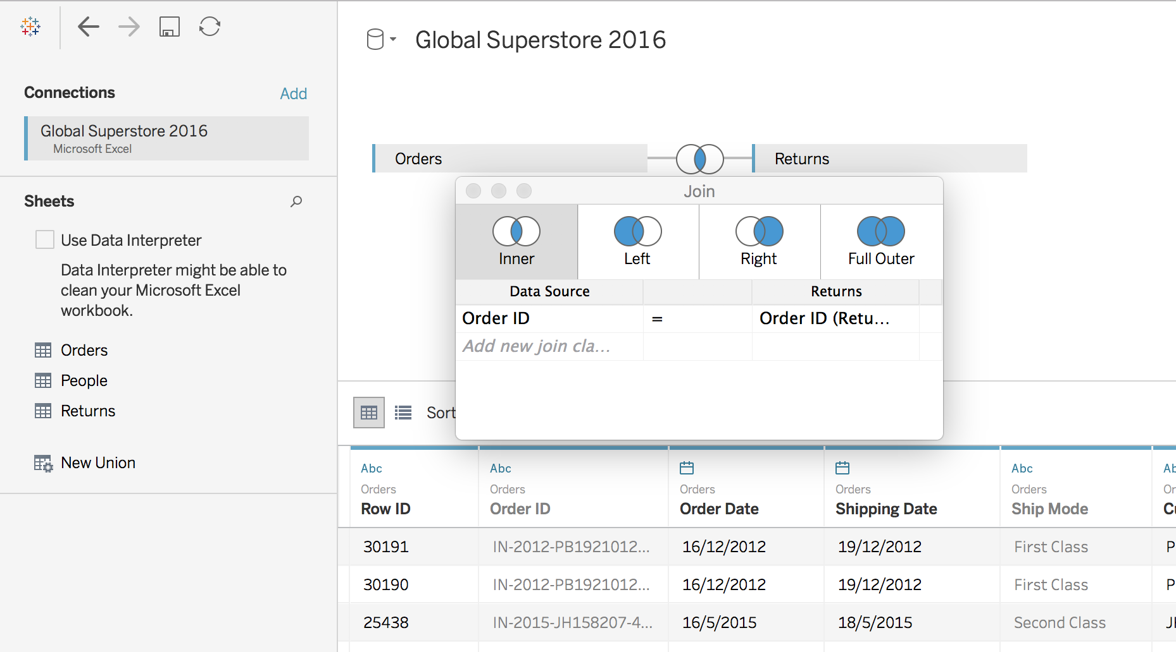
Table Join
Notes:
Demonstrate how different tables can be joined, and illustrate the difference between inner, left, right and outer joins.

Slide 25
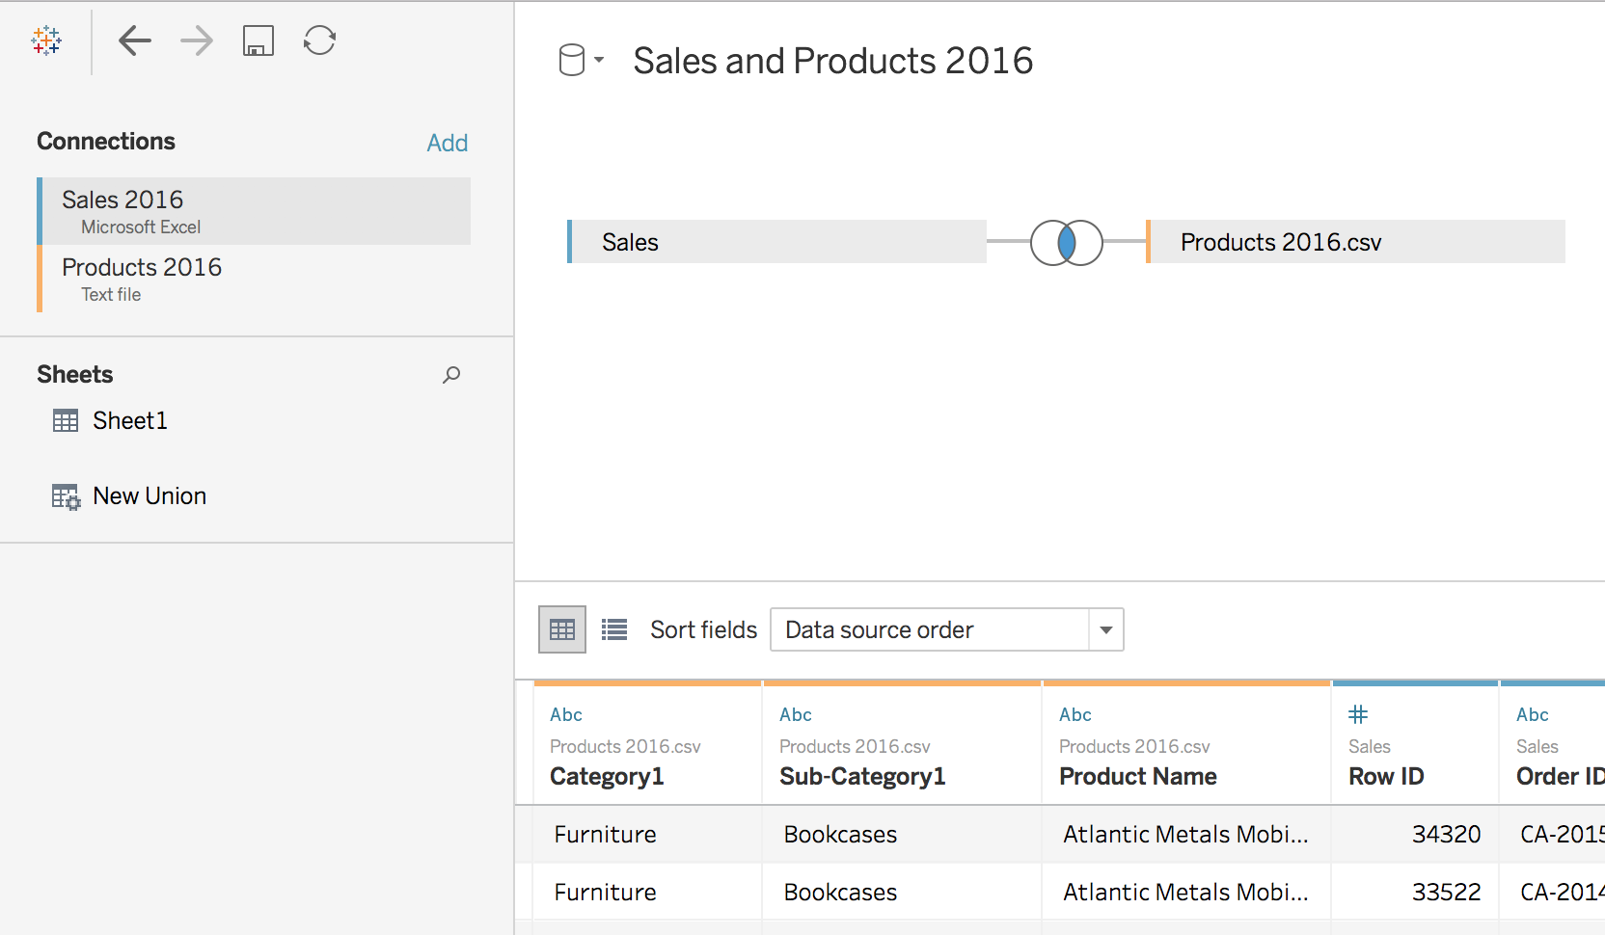
Cross-database Join
Notes:
Demonstrate join using different databases (Sales and Products 2016 data sets).

Slide 26
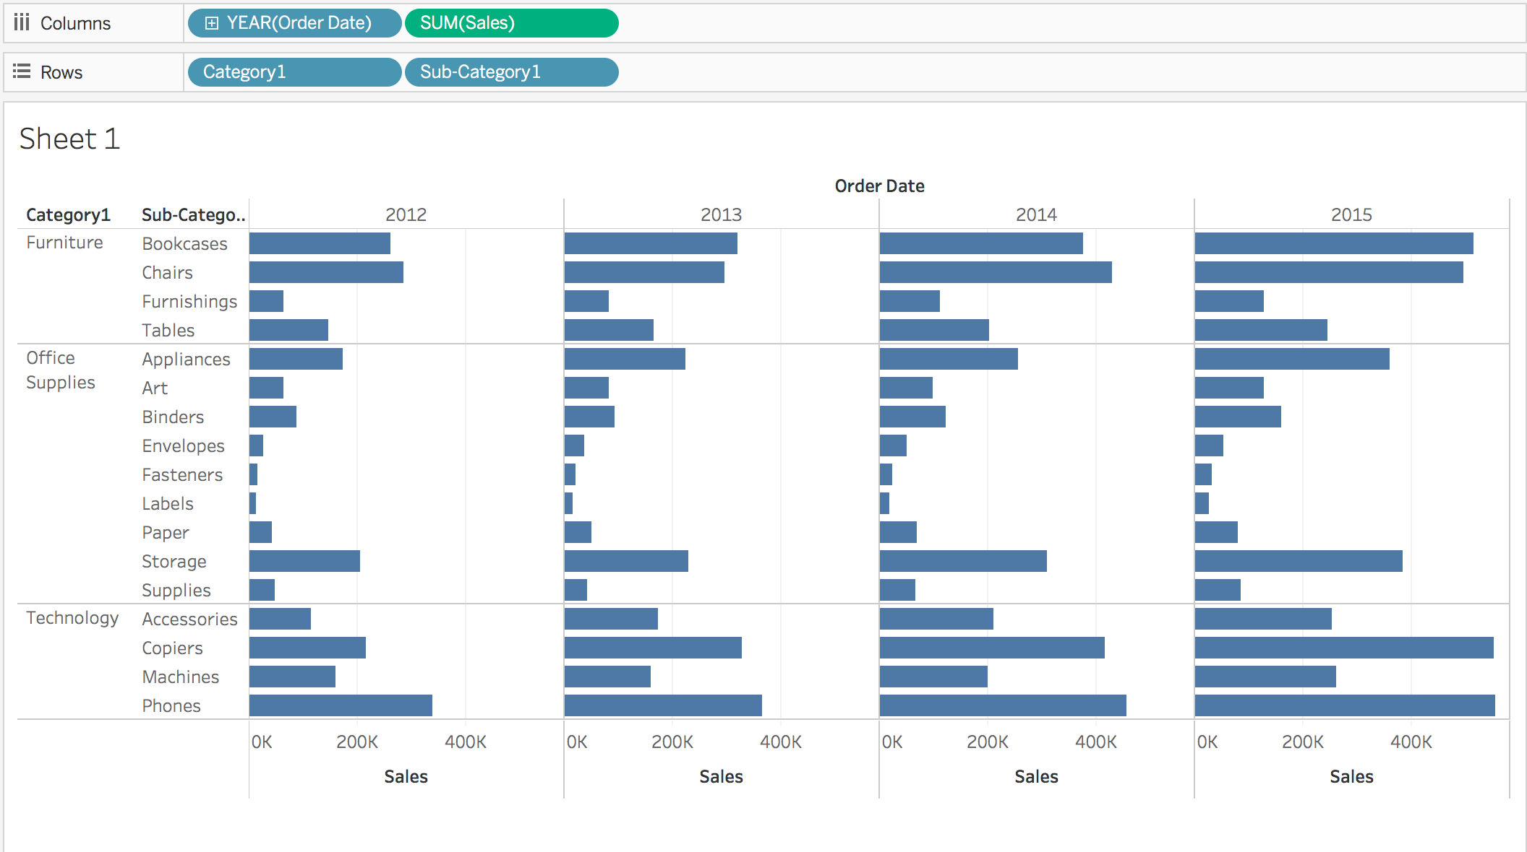
Cross-database Join

Slide 27
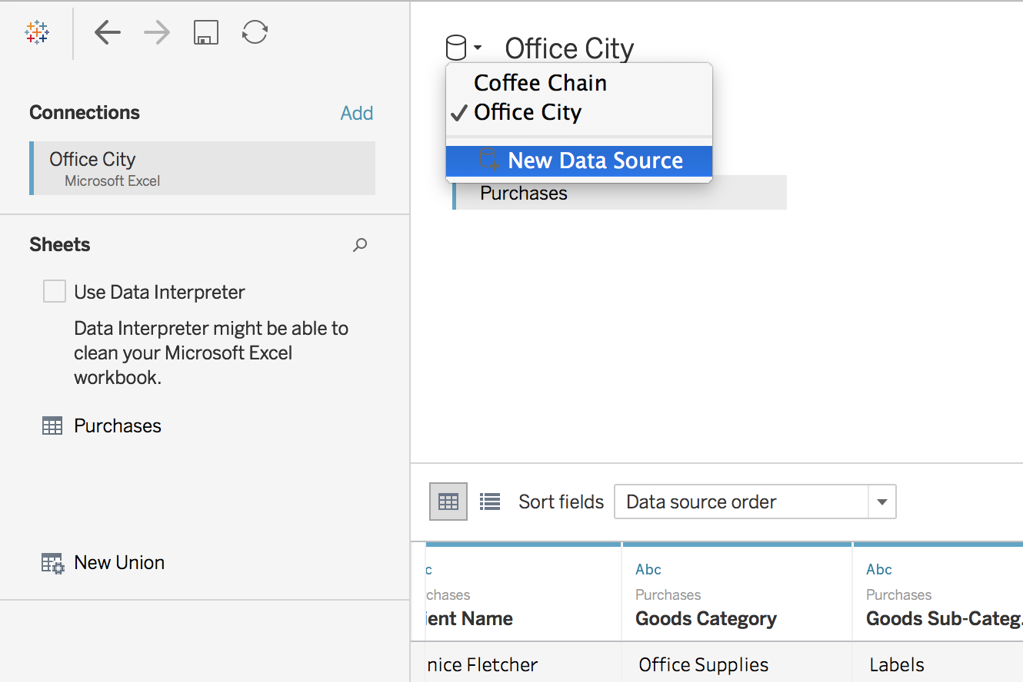
Data Blending
More info:
https://help.tableau.com/current/pro/desktop/en-us/multiple_connections.htm

Slide 28
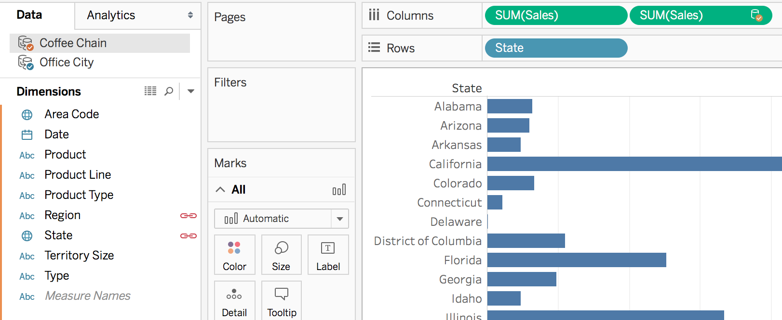
Data Blending
Discuss to identify:
Primary and Secondary data sources
linking field(s)
Notes:
Illustrate the difference between data blending and regular joins

Slide 29
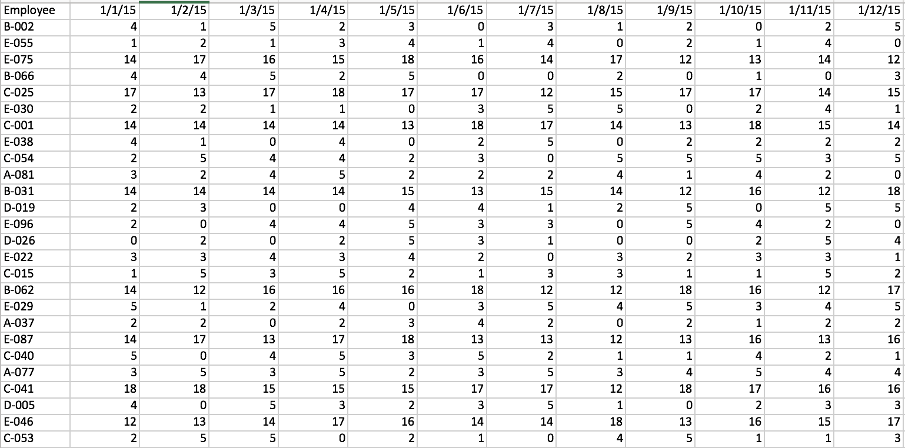
Pivot Data from Columns to Rows
Pivot from wide format to long format
More info:
https://help.tableau.com/current/pro/desktop/en-us/pivot.htm
Notes:
Make use of data_prep_flights.xlsx (resolved incidents) to demonstrate how a wide format can be pivoted to long format.

Slide 30
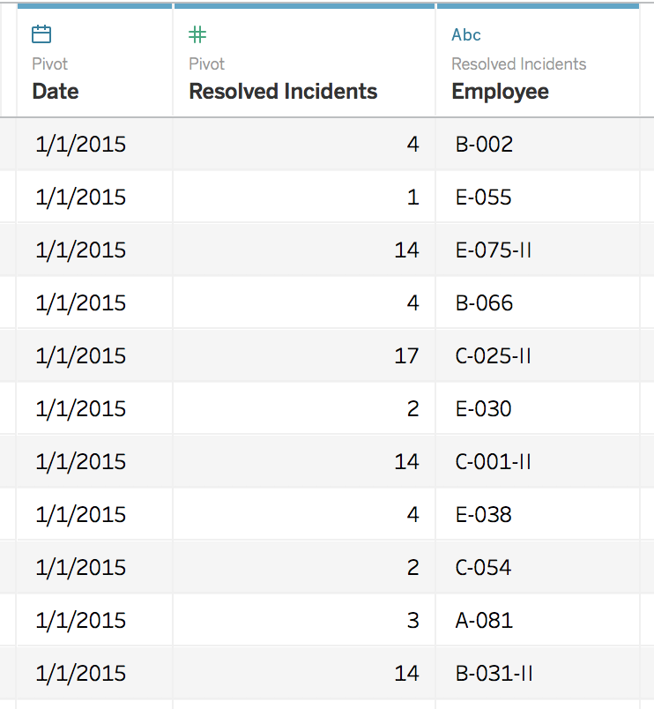
Pivot
To long format:
Notes:
highlight all the date columns and then click “pivot”

Slide 31
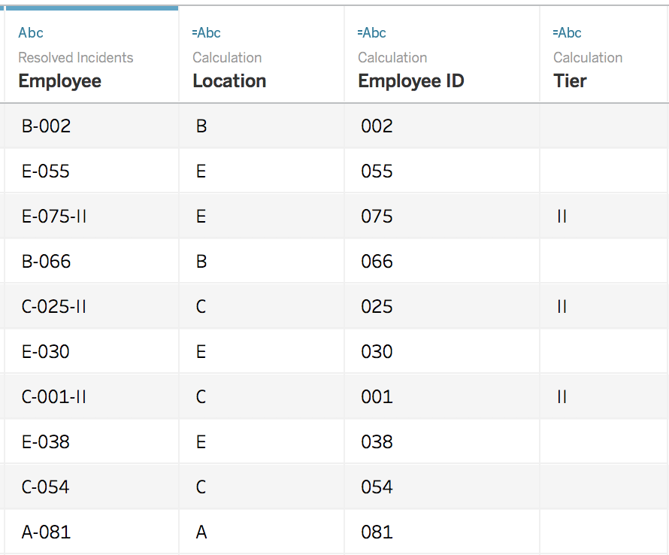
Split
Split “Employee” column:
Notes:
Click on Employee column and Split

Slide 32
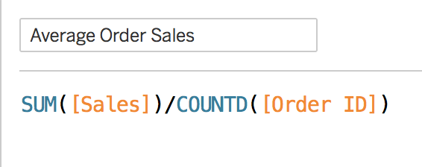
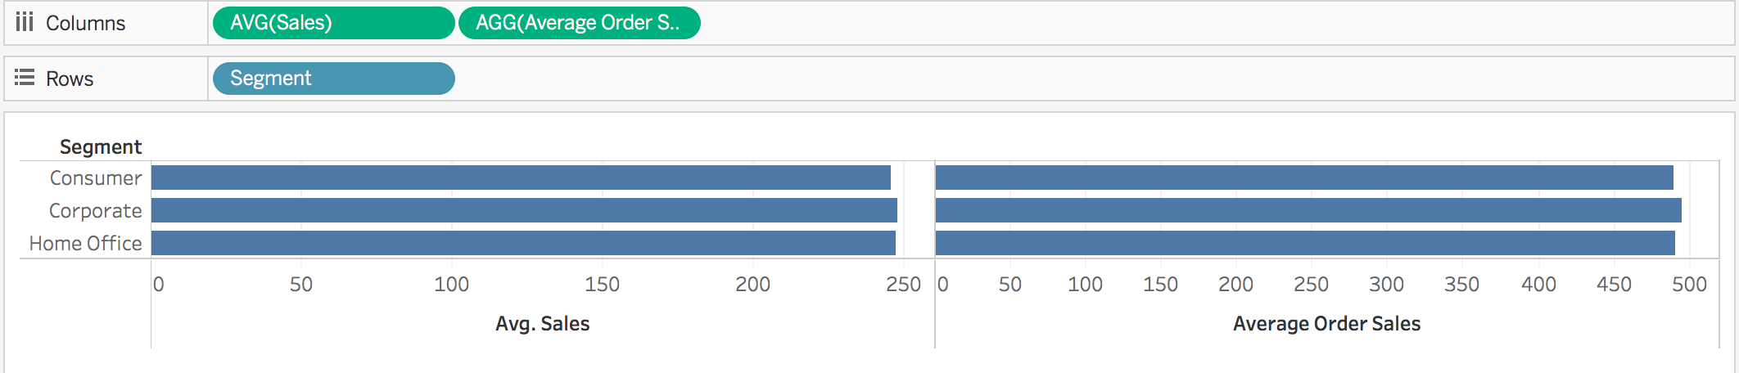
Calculation: Aggregate VS Record-Level
Notes:
Compare AVG and derived aggregated value, SUM/COUNTD sum of sales/number of distinct order
Compare AVG and derived aggregated value, SUM/COUNT sum of sales/number of order

Slide 33
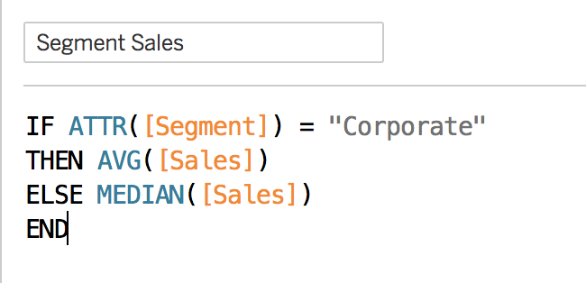
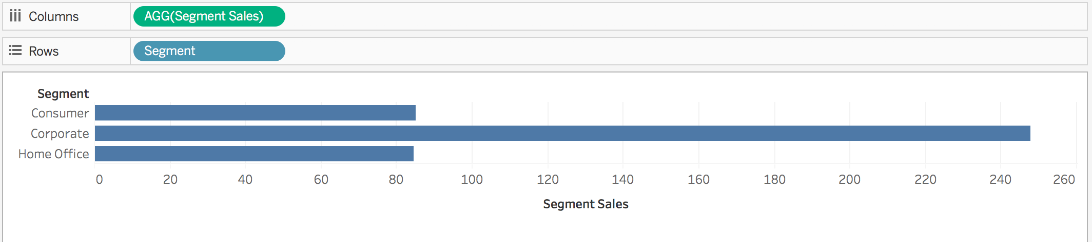
Aggregate Functions
Aggregation of a measure
Aggregation of a dimension
More information:
https://help.tableau.com/current/pro/desktop/en-us/calculations_aggregation.htm
https://help.tableau.com/current/pro/desktop/en-us/calculations_calculatedfields_aggregate_create.htm
Notes:
Part of this exercise is to illustrate the use of calculated field, and introduce students to some basic coding within Tableau.
Go through commonly used agg functions

Slide 34
Part 4 – Creating a Simple Worksheet/ Report

Slide 35
Part 4a – Visualisation of Categorical Data

Slide 36
Visualisation of Categorical Data
Visualising categorical data
Bar / Stacked Bar Chart
Side-by-side Bar Chart
Pie Chart
Area Chart
Heat Map
Tree Map

Slide 37
Visualisation of Categorical Data
Visualising categorical data — side-by-side (i.e., grouped) bar chart
Drag two or more measures into either the worksheet’s columns or rows.
Measure Values and Measure Names will then be created automatically.
Measure Names and Measure Values can be used to express various measures in a data set or multiple measures on a single axis.
Measure Values contains the data while Measure Names is used to separate the bars used on the marks
https://kb.tableau.com/articles/howto/creation-of-a-grouped-bar-chart

Slide 38
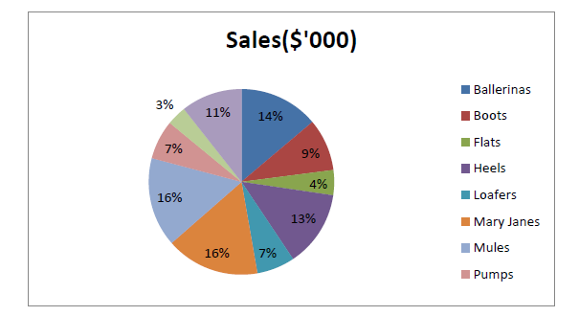
Visualisation of Categorical Data
Visualising categorical data — pie chart
Pie Chart should be used to get a general sense of magnitude, but not for precise comparisons.
A pie chart is limited by its area meaning that if you have many categories, you have many slivers and its hard to compare.
https://help.tableau.com/current/pro/desktop/en-us/buildexamples_pie.htm
Notes:
The result is a rather small pie. To make the chart bigger, hold down Ctrl + Shift (hold down ñ + z on a Mac) and press B several times.

Slide 39
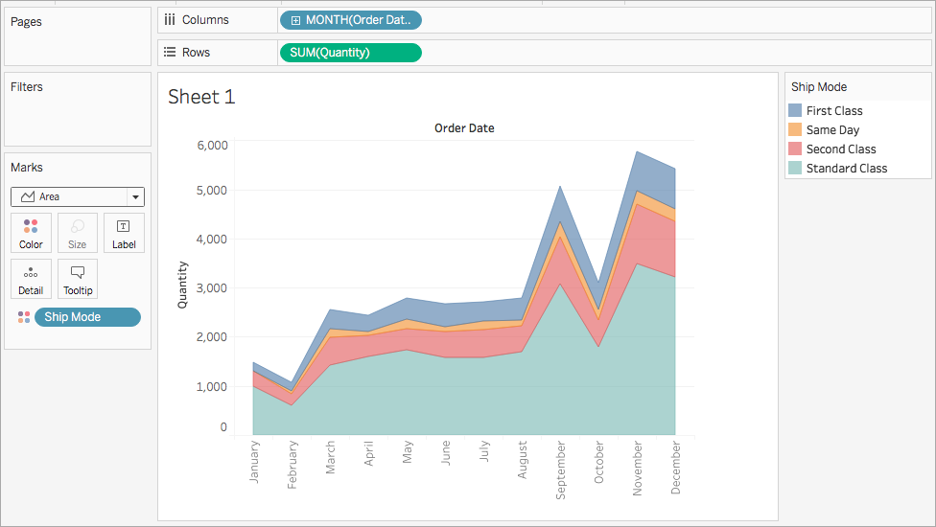
Visualisation of Categorical Data
Visualising categorical data — area chart
Area Fill chart plots values as bands, thus it is easy to misinterpret the top band as being the largest value in a data set.
The Area Fill Chart is best used to plot a single dimension to avoid such misinterpretation.
https://help.tableau.com/current/pro/desktop/en-us/qs_area_charts.htm

Slide 40
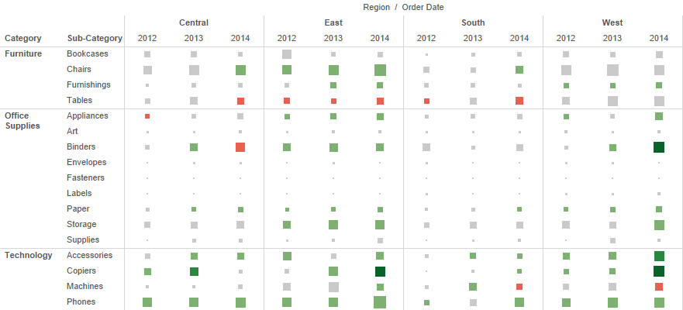
Visualisation of Categorical Data
Visualising categorical data — heat map
Heat Maps use colours and sizes to compare up to two measures.
https://help.tableau.com/current/pro/desktop/en-us/buildexamples_highlight.htm

Slide 41
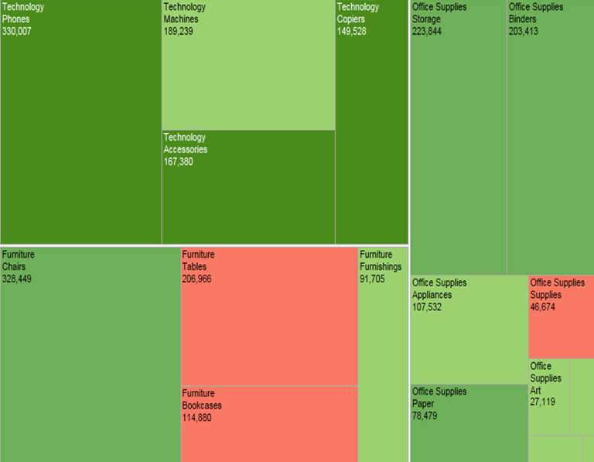
Visualisation of Categorical Data
Visualising categorical data — tree map
Treemaps effectively display larger dimension sets using colours and sizes to display one or more dimensions, and up to two measures.
https://help.tableau.com/current/pro/desktop/en-us/buildexamples_treemap.htm

Slide 42
Part 4b – Visualisation of Time Series Data

Slide 43
Visualisation of Time Series Data
Discrete (bucketed) time series data
Discrete time series data values are from specific points or blocks of time, and there is a finite number of possible values
A line chart is the most effective way to display time series data. A line chart for discrete time series data places breaks between time units like year, quarter, month and day
Bar, stacked bar charts, and scatterplots can also be used to display time series data
The power of “Time Series Analysis” lies in looking for trends in temporal data and forecasting i.e., based on what I see in the past, can I predict the future? Is this pattern seasonal/cyclical?
A whole picture view is more important than the individual data points

Slide 44
Visualisation of Time Series Data
Continuous (unbroken) time series data
Visualising continuous time series data is similar to visualising discrete time series data. We still have a discrete number of data points, even if the dataset is continuous
Line chart for continuous time series data is presented as unbroken lines
Step charts are appropriate if the measure stays at a value for a long time and all of a sudden declines or inclines
Trendlines are useful in the presence of noisy data or large amounts of data
Notes:
A Step chart is a Line chart that does not use the shortest distance to connect two data points. Instead, it uses vertical and horizontal lines to connect the data points in a series forming a step-like progression. The vertical parts of a Step chart denote changes in the data and their magnitude. The horizontal parts of a Step chart denote the constancy of the data.

Slide 45
Visualisation of Time Series Data
Visualising time series data
Powerful Story Telling Tool – Crude Price & History
Line Chart
Sparkline Chart
Gantt Chart
Trendline
Reference Line

Slide 46
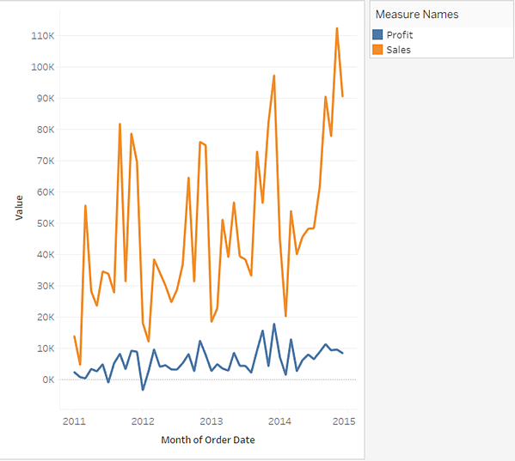
Visualisation of Time Series Data
Visualising time series data – line chart
Useful for data that does not stay constant i.e., is variable.
Data that stays constant, then suddenly changes, then stays constant etc is better visualized with a “step” graph
Data that is TOO highly variable (noisy data) sometimes needs to be smoothed and/or a “trend line” can be applied to make sense of it
https://help.tableau.com/current/pro/desktop/en-us/buildexamples_line.htm

Slide 47
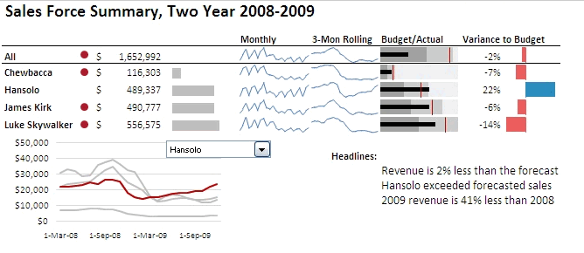
Visualisation of Time Series Data
Visualising time series data – sparkline chart
Information is displayed in a compact manner. However, this is a difficult plot style to grasp. Each element must be explained, and the audience needs to be guided
https://kb.tableau.com/articles/howto/creating-sparklines
Notes:
A sparkline is a very small line chart, typically drawn without axes or coordinates. It presents the general shape of the variation (typically over time) in some measurement, such as temperature or stock market price, in a simple and highly condensed way. Sparklines are small enough to be embedded in text, or several sparklines may be grouped together as elements of a small multiple. Whereas the typical chart is designed to show as much data as possible, and is set off from the flow of text, sparklines are intended to be succinct, memorable, and located where they are discussed.
Remember, sparklines are not quite like regular charts or graphs in that they are meant to provide quick trends at a glance. They don’t usually contain typical context, such as the axis values.

Slide 48
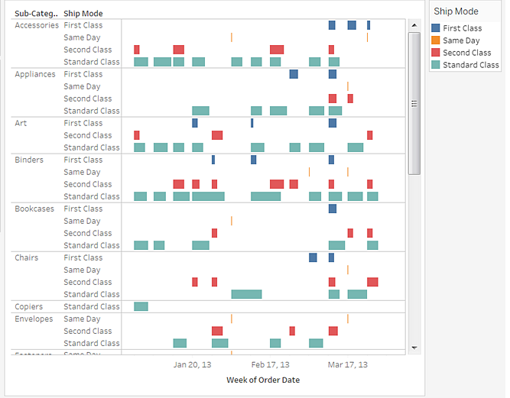
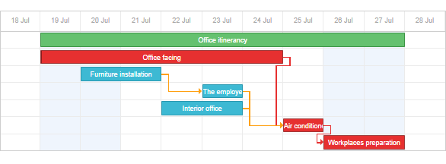
Visualisation of Time Series Data
Visualising time series data — gantt chart
Great project managing tool; has duration information and events/resources are visualized as bars. The physical position of the bars denotes start and end time; length is (obviously) duration.
Gantt charts also allow you to trace the “critical path”. Critical path analysis shows the sequence of scheduled tasks that determine the duration of a project. A critical path analysis identifies which tasks you must complete in order to meet your project deadline.
https://help.tableau.com/current/pro/desktop/en-us/buildexamples_gantt.htm
Notes:
Use Gantt charts to show the duration of events or activities.
In a Gantt chart, each separate mark (usually a bar) shows a duration. For example, you might use a Gantt chart to display average delivery time for a range of products.
The Gantt Chart is commonly being used in project planning. Activity or event start time is visualised by the bar’s horisontal position, and the duration of each activity or event is visualised by the individual bar length. Thus, this chart will be useful to visualise the timing and duration of activities or events.

Slide 49
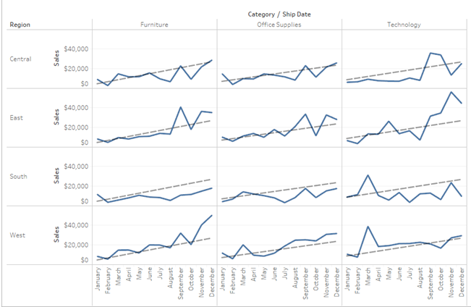
Visualisation of Time Series Data
Visualising time series data — adding a trend line
https://help.tableau.com/current/pro/desktop/en-us/trendlines_add.htm
Notes:
The Trend Line can help us see patterns that can provide predictive value, by drawing a line that best fits the values in the visualisation.
When we try to visualise granular data, sometimes it results in random looking Data Visualisation. The Trend Line can help us see patterns that can provide predictive value, by drawing a line that best fits the values in the visualisation.

Slide 50
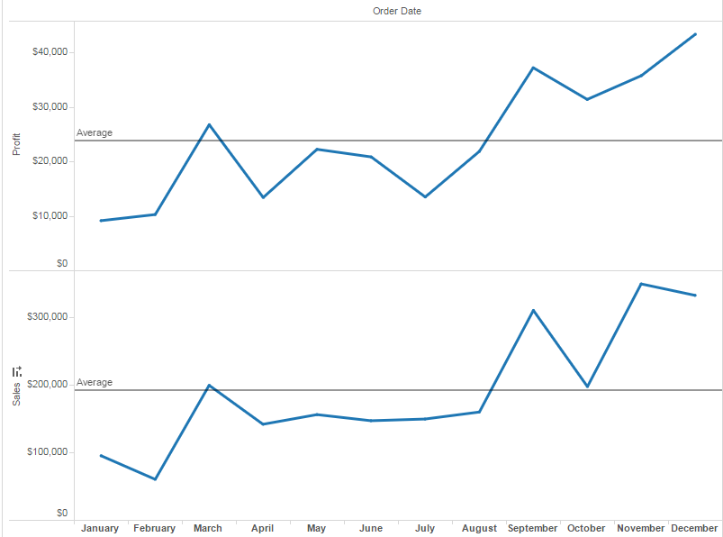
Visualisation of Time Series Data
Visualising time series data — adding a reference line/band/distribution/boxes
https://help.tableau.com/current/pro/desktop/en-us/reference_lines.htm
Notes:
The Reference Line can help us compare the actual data presented in the visualisation against targets, create statistical analyses of the deviation contained in the visualisation, or create the range of values based on fixed or calculated numbers.
The Reference Line can help us compare the actual data presented in the visualisation against targets, create statistical analyses of the deviation contained in the visualisation, or create the range of values based on fixed or calculated numbers. By looking at the Reference Line, we will be able to identify outliers that may require our attention or additional analysis.

Slide 51
Tableau Class Activity
Building a Simple Worksheet/ Report
Visualisation of Categorical Data
Visualisation of Time Series Data

Slide 52

Tableau (Class Activity)
Ensure that you have a working copy of Tableau Desktop installed on your computer
Ensure that you have the following datasets downloaded onto your computer:
global_superstore_2016.xlsx
Sales 2016.xlsx
Products 2016.csv
Coffee Chain.xlsx
Office City.xlsx
Time to power up Tableau!

Slide 53
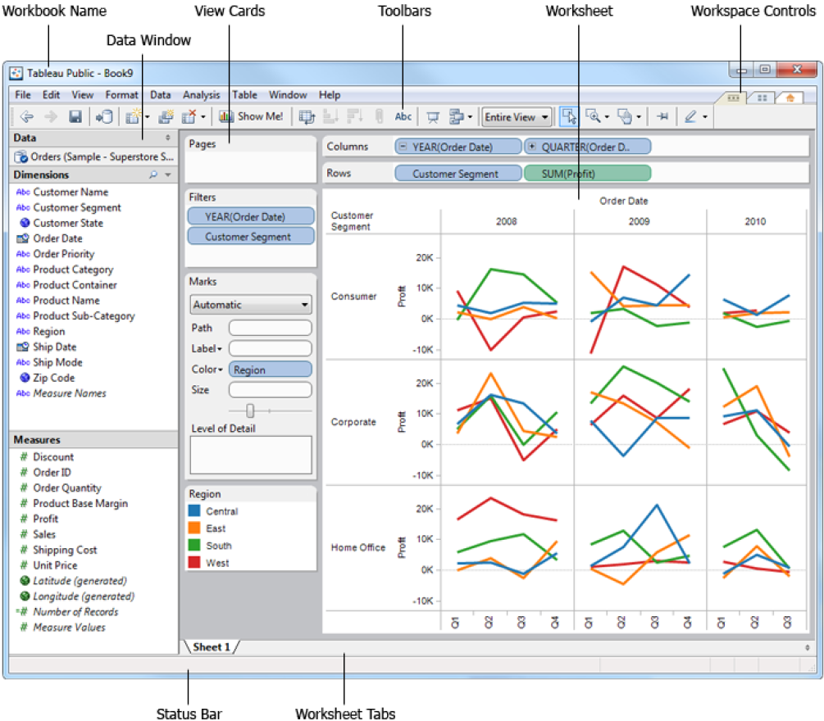
Notes:
Let the students know that is always a good practice to visualise the chart that they want to have for a report or dashboard before they start creating the report or dashboard.
The result is a rather small pie. To make the chart bigger, hold down Ctrl + Shift (hold down ñ + z on a Mac) and press B several times.
Use Global Superstore 2016 – Order Data [Filter at the Data Source only US]
Do a brief recap on how to load the data into Tableau. Tableau will auto detect whether the variable is a measure or dimension but is always to run through to ensure that is correctly assigned.
Tell the students that is a good practice to name the worksheet, give a title and show the caption. Tableau uses one worksheet per chart.
Simple Report – Sum of profit by region and customer segment
Note to students that the measure can be changed from sum to average, median, count, count(distinct)
2. Two Measures Report – Break down sum and average of profit by product category
3. Pie Chart – Use customer segment for colour of the pie, sum of profit for size and angle, show the segment name using label and show the % of the segment using label as well. To show % of the segment, go to Analysis and check Table under Percentage of. Explain the pie chart briefly such as consumer segment is the largest segment at 46.83% followed by Corporate at 32.12%.

Slide 54
Tableau (Class Activity)
Follow your instructor for the followings exercises:
Import Excel data: global_superstore_2016.xlsx (orders)
Build a simple worksheet/ report
Notes:
Demo on superstore (Excel) for order table
Creating the worksheet

Slide 55
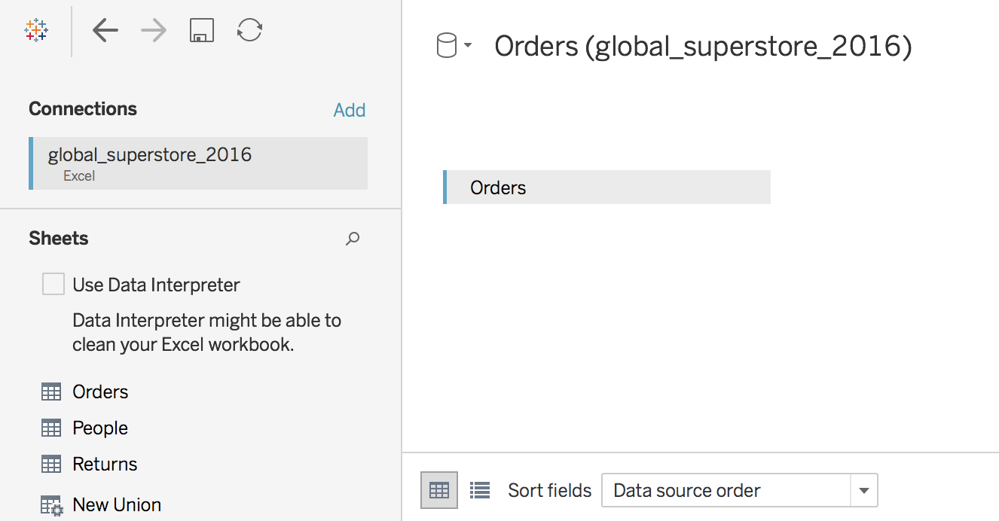
Tableau (Class Activity)

Slide 56
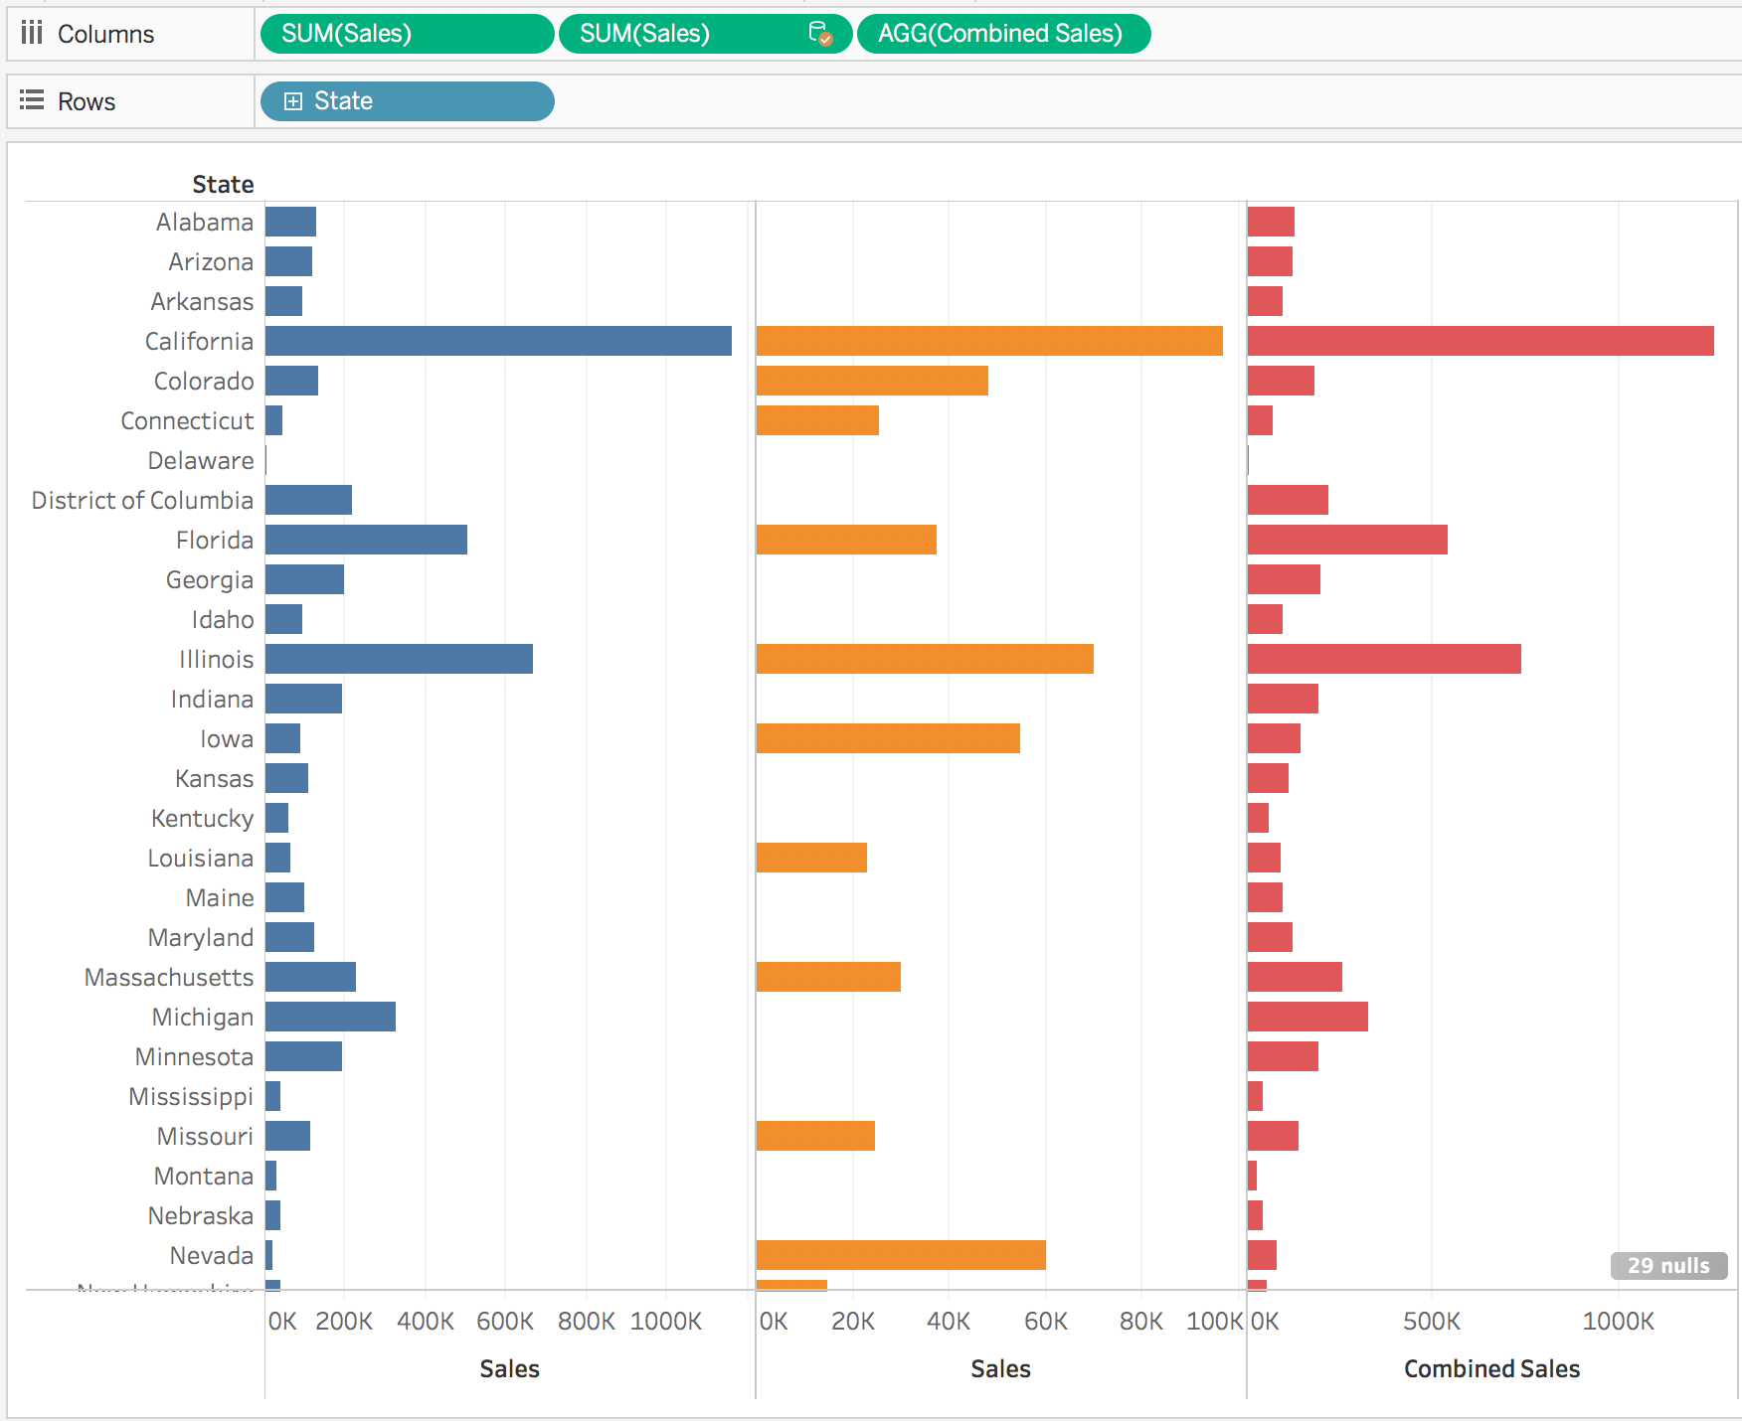
Exercise
Create a calculated field: for each state, calculate combined sales from office city.xlsx and coffee chain.xlsx
Notes:
Illustrate how the sales figure from the 2 different data sets can be combined based on the state name.

Slide 57
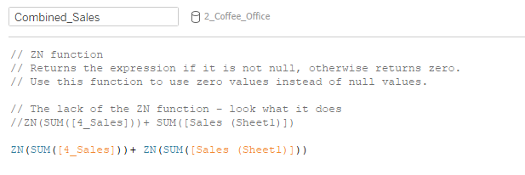
Exercise
Create a calculated field: for each state, calculate combined sales from office city.xlsx and coffee chain.xlsx
Notes:
Illustrate how the sales figure from the 2 different data sets can be combined based on the state name.

Slide 58
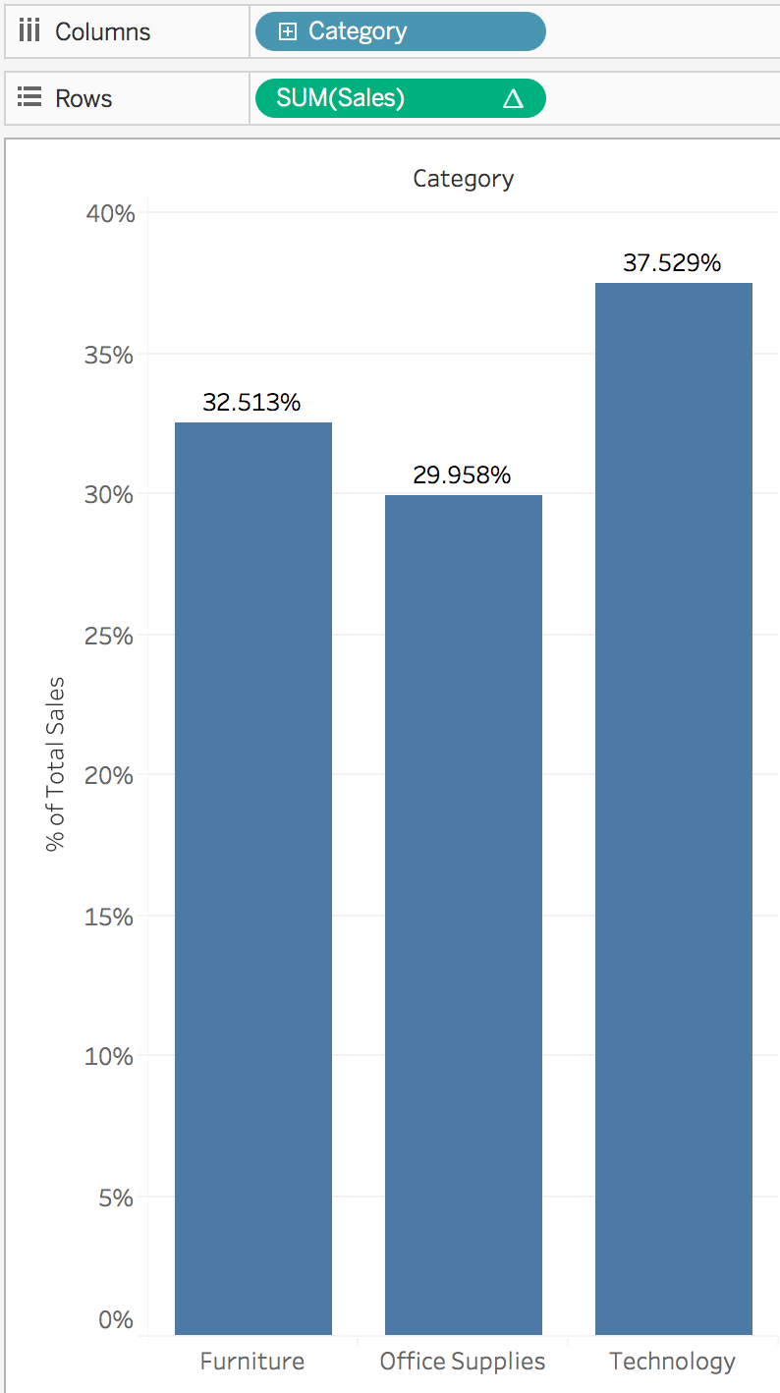
Quick Table Calculation
percent of total
Notes:
Make use of global_superstore_2016.xlsx (orders) for this exercise to guide students on the use of quick table calculation.
Go to “Rows” and select drop down menu of “Sum(sales)”.
Select “Add Table Calculation” and change Calculation Type to “Running total”.

Slide 59
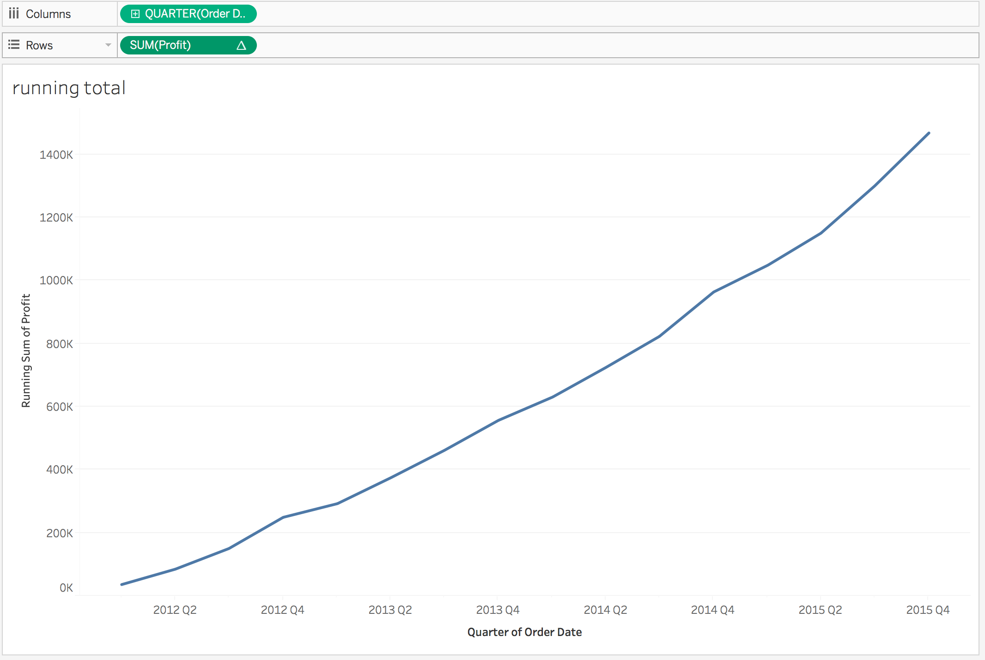
Quick Table Calculation
running total

Slide 60
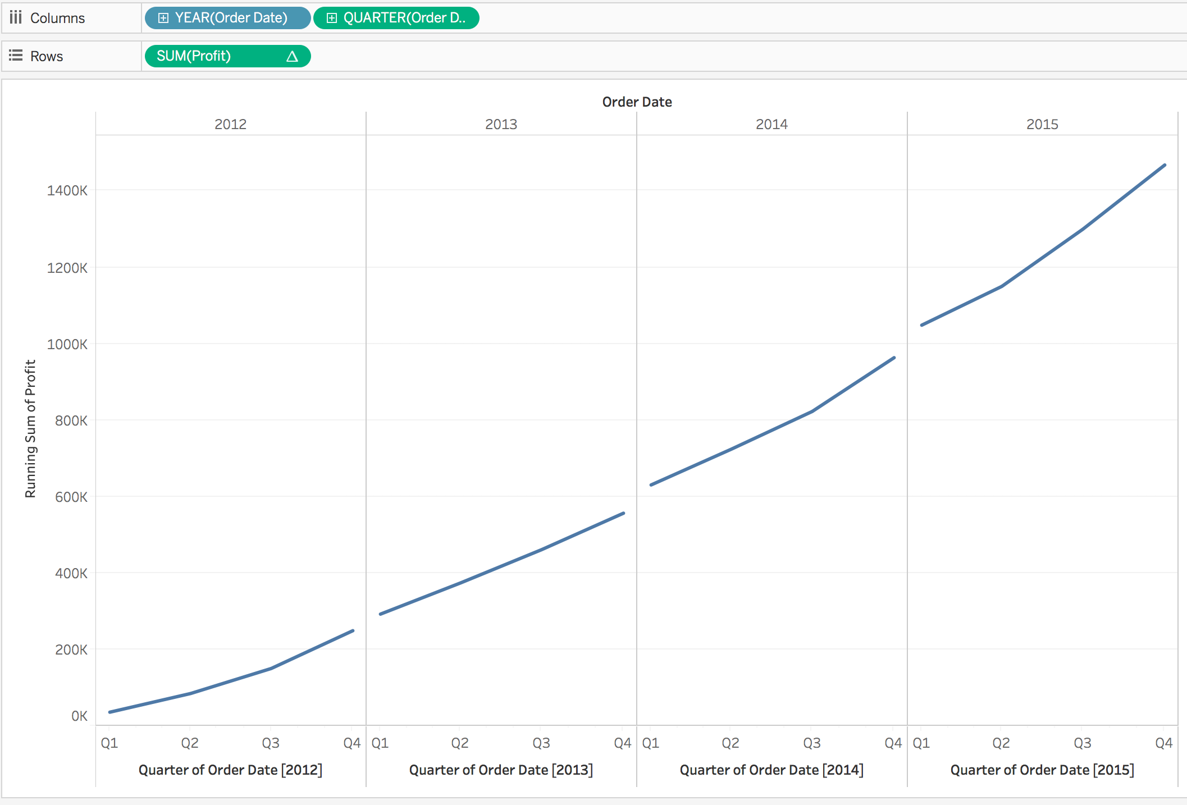
Quick Table Calculation
running total for each year: Is this chart correct?

Slide 61
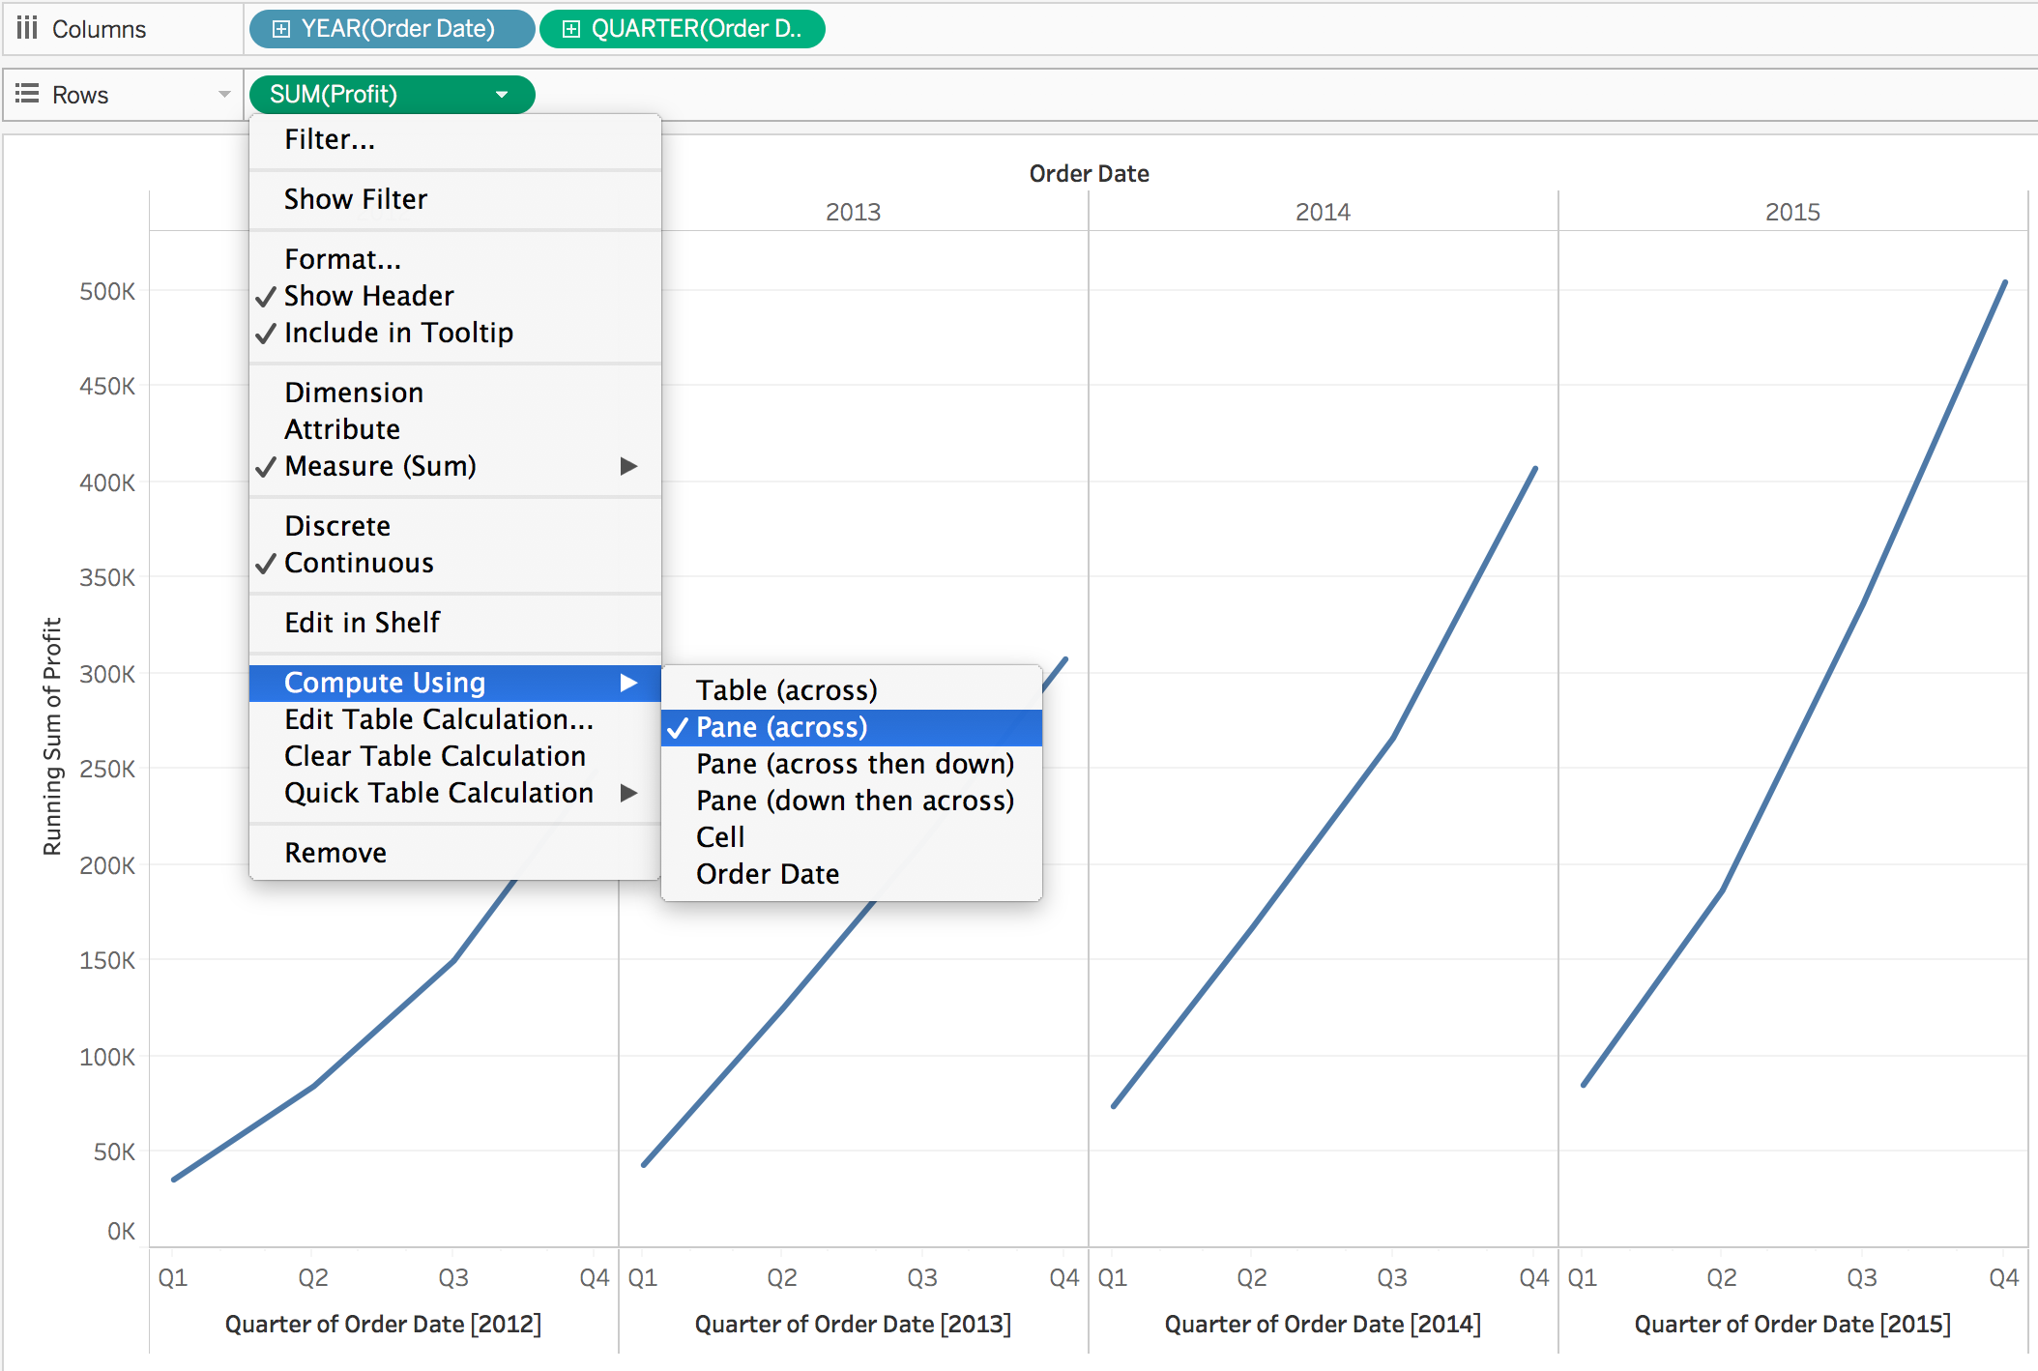
Quick Table Calculation
running total for each year:
Notes:
Illustrate the differences between the different options under “Compute Using”

Slide 62
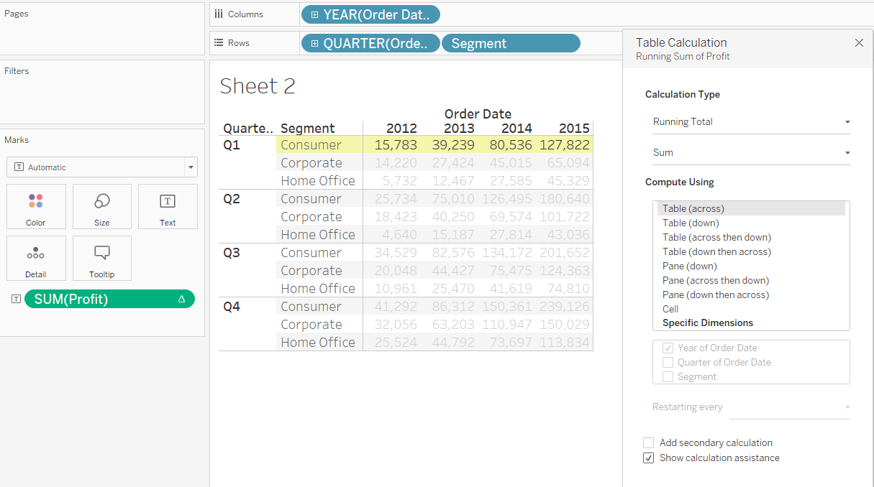
Quick Table Calculation
Compare “Compute Using”:
Notes:
Illustrate the differences between the different options under “Compute Using”

Slide 63
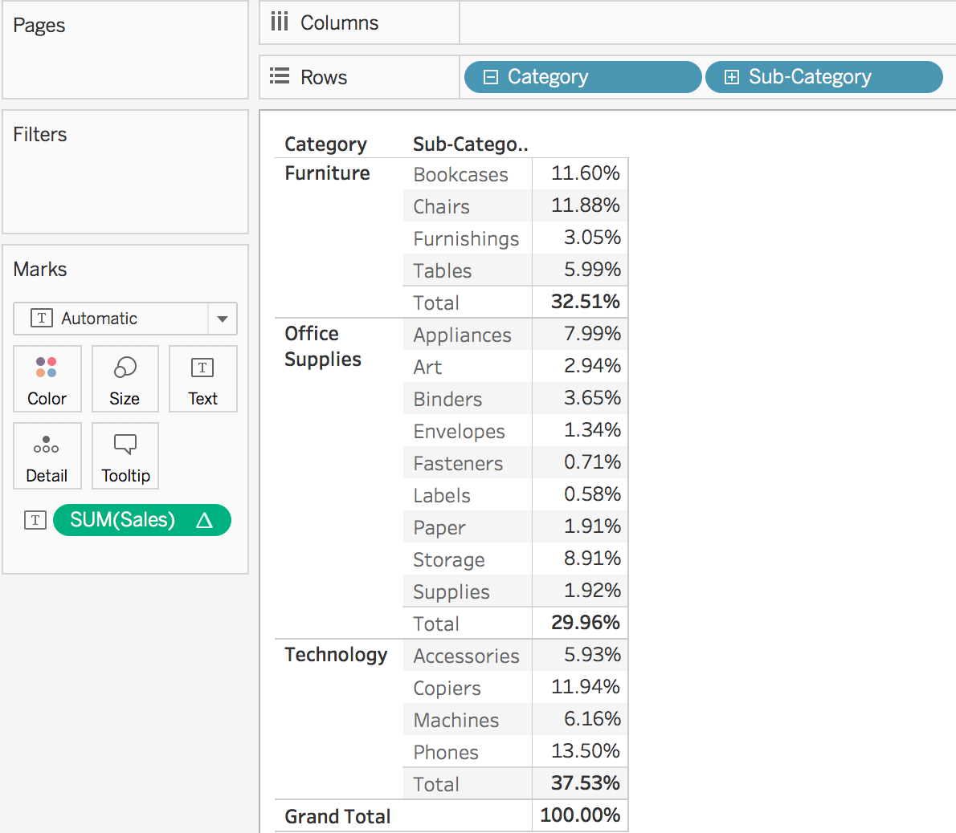
Quick Table Calculation
More Information:
https://help.tableau.com/current/pro/desktop/en-us/calculations_tablecalculations.htm

Slide 64
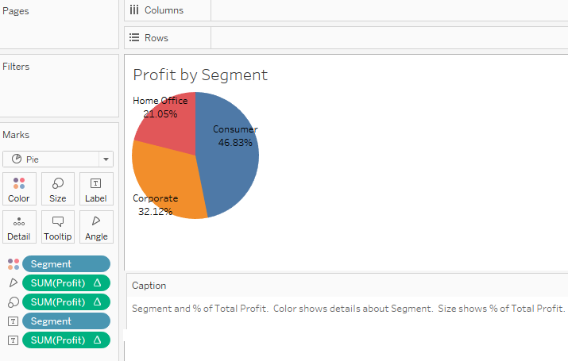
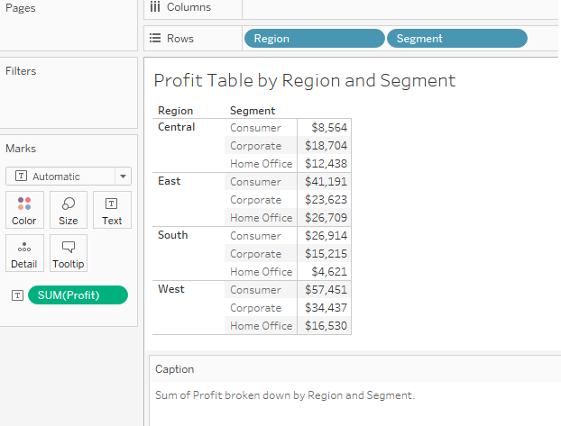
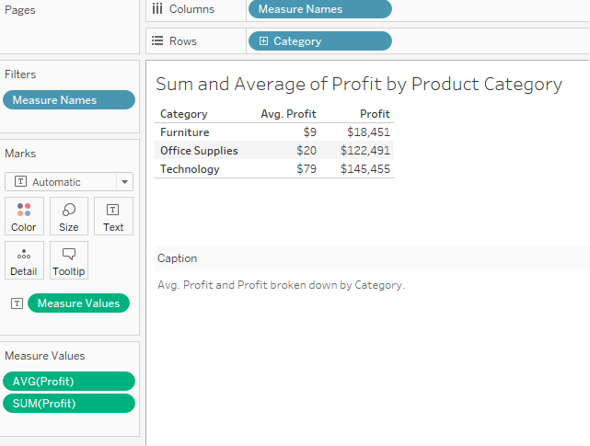
Tableau (Class Activity)
Simple Report
Pie Chart
Two-Measures Report
Notes:
Let the students know that is always a good practice to visualise the chart that they want to have for a report or dashboard before they start creating the report or dashboard.
The result is a rather small pie. To make the chart bigger, hold down Ctrl + Shift (hold down ñ + z on a Mac) and press B several times.
Use Global Superstore 2016 – Order Data [Filter at the Data Source only US]
Do a brief recap on how to load the data into Tableau. Tableau will auto detect whether the variable is a measure or dimension but is always to run through to ensure that is correctly assigned.
Tell the students that is a good practice to name the worksheet, give a title and show the caption. Tableau uses one worksheet per chart.
Simple Report – Sum of profit by region and customer segment
Note to students that the measure can be changed from sum to average, median, count, count(distinct)
2. Two Measures Report – Break down sum and average of profit by product category
3. Pie Chart – Use customer segment for colour of the pie, sum of profit for size and angle, show the segment name using label and show the % of the segment using label as well. To show % of the segment, go to Analysis and check Table under Percentage of. Explain the pie chart briefly such as consumer segment is the largest segment at 46.83% followed by Corporate at 32.12%.

Slide 65
Tableau (Class Activity)
Sit with your GBA’s team mates
Follow your instructor to create the followings:
Simple report
Two measures report
Pie chart
Bar chart with reference line
Stacked bar chart
Line chart with trend line
Line chart with 2 axis
Area chart
Bullet chart
Gantt chart
Heat Map

Slide 66
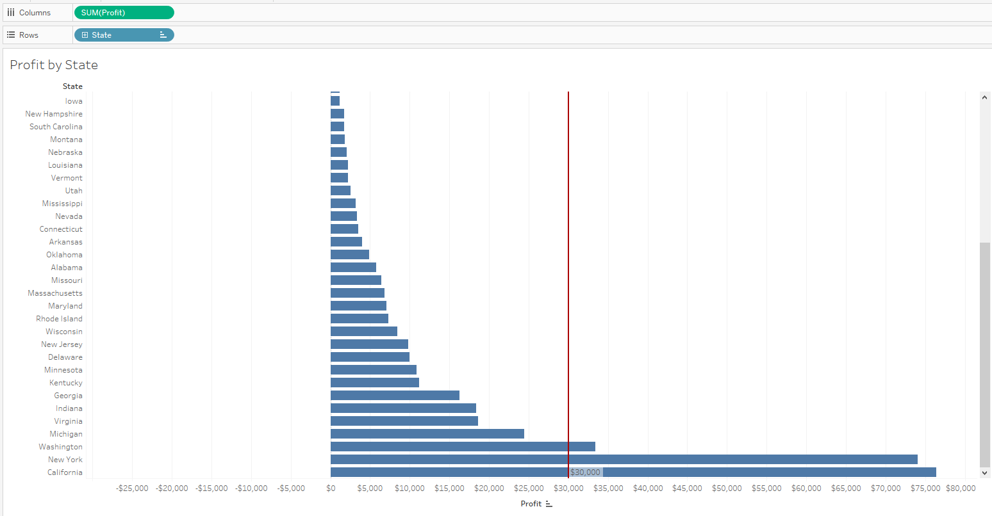
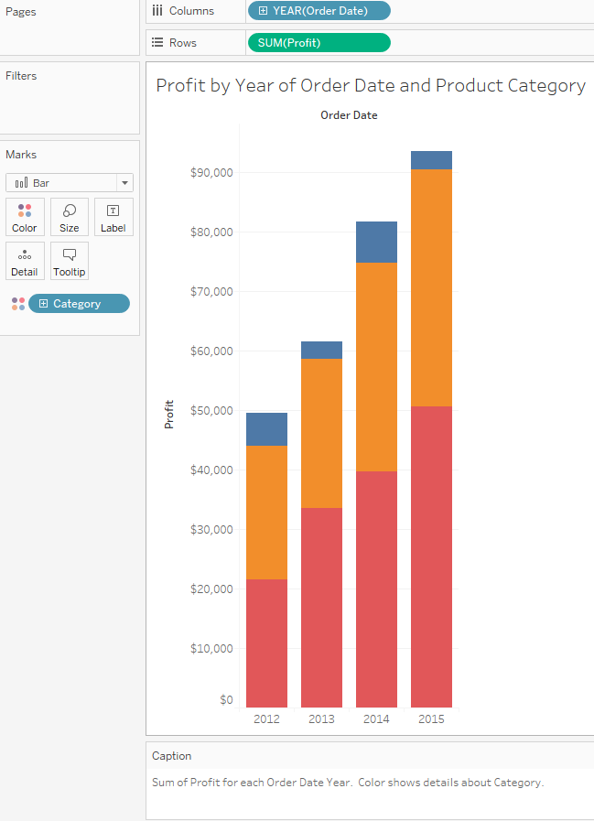
Tableau (Class Activity)
Bar Chart with reference line
Stacked Bar Chart
Notes:
4. Bar Chart with reference line– Set Sum(Profit) to be column and State to be Rows. Sort the profit ascending. Create a reference at 30,000 (Right Click at Axis) and change the colour to red. Explain the reference line. Show the students that the row and col can be swapped. Explain the chart briefly.
5. Stacked Bar Chart – Set Year of Order Date to be column and Sum(Profit) to be Rows, set product category to be the colour of the stack. Explain that Tableau will usually plot the highest order of date which is year and drill down to show quarters and months. Explain the chart briefly.

Slide 67
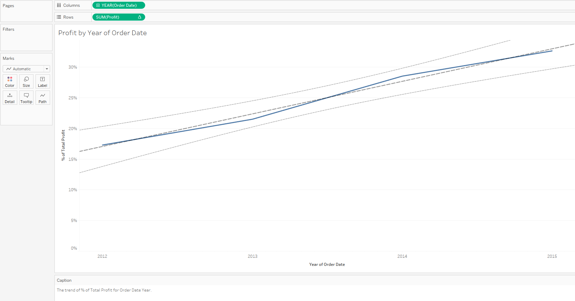
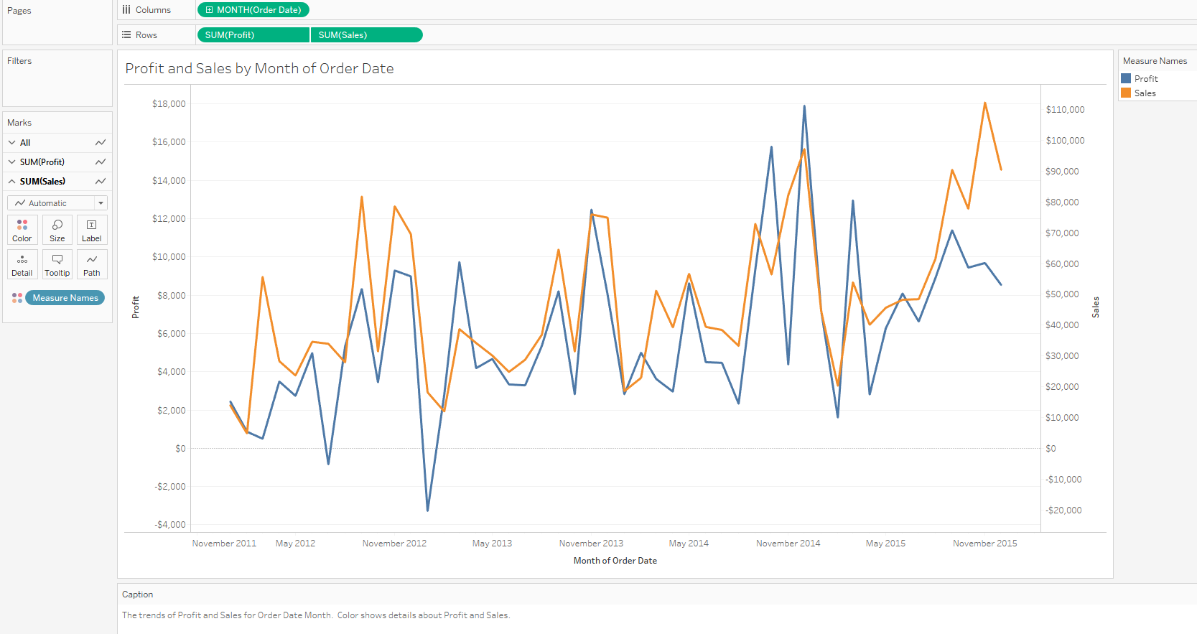
Tableau (Class Activity)
Line Chart with trend line
Line Chart with 2 Y-axis
Notes:
6. Line Chart with trend line – Set Year of Order Date to be column and Sum(Profit) to be Rows. Create the trend line and explain the trend line. Explain the chart briefly. (Right Click on Trend Line)
7. Line Chart with 2 Y-axis - Set Year of Order Date to be column and Sum(Profit) and sum(Sales) to be Rows. Put Measures name as colour. Explain the chart briefly. Right click the sales-axis, select dual axis.
The T distribution, also known as the Student's t-distribution, is a type of probability distribution that is similar to the normal distribution with its bell shape but has heavier tails. T distributions have a greater chance for extreme values than normal distributions, hence the fatter tails.
The null hypothesis states that there is no relationship between the two variables being studied (one variable does not affect the other). It states the results are due to chance and are not significant in terms of supporting the idea being investigated. Thus, the null hypothesis assumes that whatever you are trying to prove did not happen.
The level of statistical significance is often expressed as a p-value between 0 and 1. The smaller the p-value, the stronger the evidence that you should reject the null hypothesis.
A p-value less than 0.05 (typically ≤ 0.05) is statistically significant. It indicates strong evidence against the null hypothesis, as there is less than a 5% probability the null is correct (and the results are random). Therefore, we reject the null hypothesis, and accept the alternative hypothesis.
However, this does not mean that there is a 95% probability that the research hypothesis is true. The p-value is conditional upon the null hypothesis being true is unrelated to the truth or falsity of the research hypothesis.
A p-value higher than 0.05 (> 0.05) is not statistically significant and indicates strong evidence for the null hypothesis. This means we retain the null hypothesis and reject the alternative hypothesis. You should note that you cannot accept the null hypothesis, we can only reject the null or fail to reject it.
A statistically significant result cannot prove that a research hypothesis is correct (as this implies 100% certainty).
Instead, we may state our results “provide support for” or “give evidence for” our research hypothesis (as there is still a slight probability that the results occurred by chance and the null hypothesis was correct – e.g. less than 5%).

Slide 68
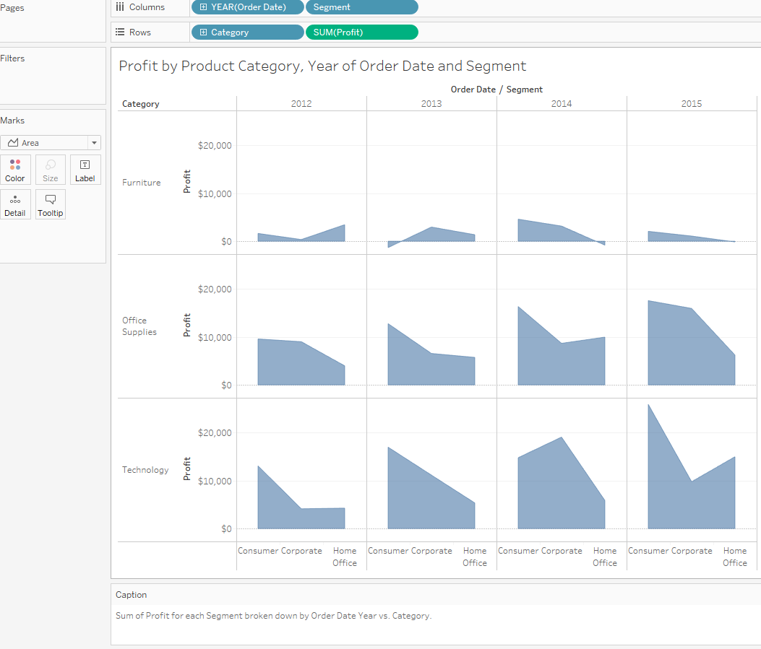
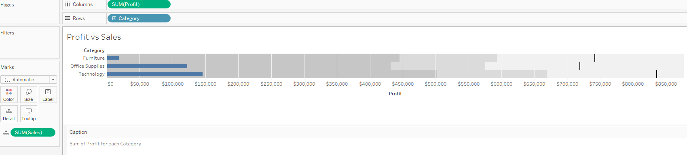
Tableau (Class Activity)
Area Chart
Bullet Chart
Notes:
8. Area Chart – Set Year of Order Date and customer segment to be column and product category and Sum(Profit) to be Rows. Explain the chart briefly.
9. Bullet Chart – Bullet chart is usually created to compare actual with target. For this dataset, we will compare profit with sales. Set sum(profit) to be column and product category to be rows. Set sum(sales) as detail. Explain to the students that the reference lines can be swapped and edit. Explain the chart briefly. Bring in Sales and Profit, then click on Bullet chart], then bring in Category

Slide 69
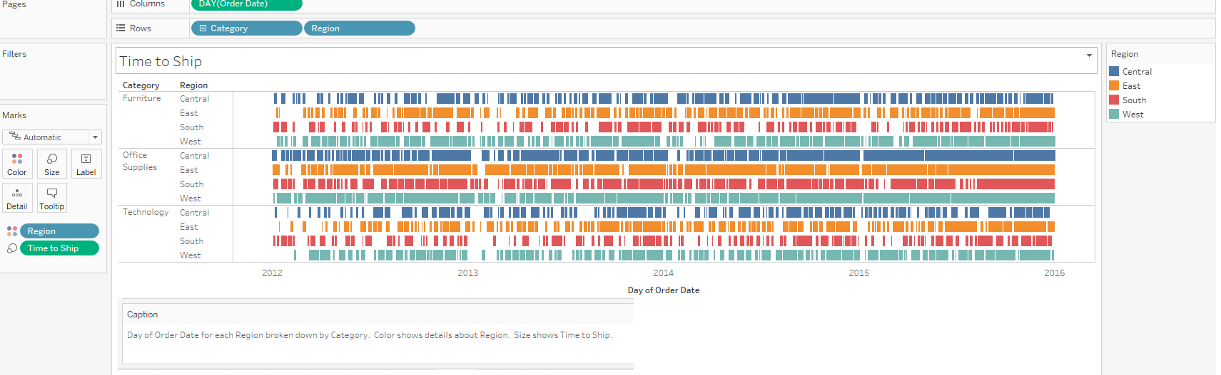
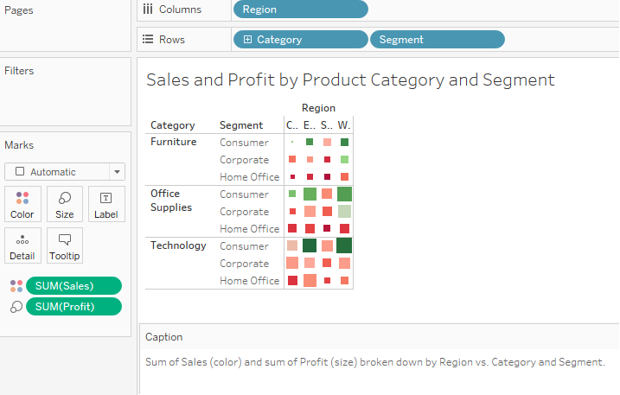
Tableau (Class Activity)
Gantt Chart
Heat Map
Notes:
10. Gantt Chart – Uncheck Aggregate measures and explain why this need to be done. Create a calculated field, Time to Ship which is ship date – order date. Set Day of Order Date to be column and product category and region to be Rows. Set colour to be region and size to Time to Ship. Explain the chart briefly.
11. Heat Map - Set region to be column and product category and customer segment to be Rows. Set colour to be sum(sales) and size to sum(Profit). Explain the chart briefly.

Slide 70
Part 5a - Visualisation of Spatial Data

Slide 71
Visualisation of Spatial Data
Best practices for visualising spatial data (1/2)
The most common way to visualise spatial data is with maps that place values within a geographic coordinate. We can visualise the geographic coordinate of a location by mapping the latitude and longitude coordinates to two-dimensional space, and draw a point on the space.
When the density of individual locations across a region is more informative than the overlapping points on a map, we may want to colour code the region based on the density scale, or use lines to show data continuously over geography.

Slide 72
Visualisation of Spatial Data
Best practices for visualising spatial data (2/2)
We can also size the regions by the data and ignore the physical area, so that the regions with high density data will appear bigger than the regions with low density data
If we want to explore relationships between entities, we can plot each entity on a map, and draw lines to connect each with the others they are associated with
A practical tip - there is a “local” context component to spatial data mapping. For example, would you expect someone who has never been to Singapore to know where Clementi is on a map, unless its explicitly pointed out?
Maps require that you have some background knowledge of the locale; therefore, if you want to use maps, know your audience!

Slide 73
Visualisation of Spatial Data
Visualising spatial data
Map
Mapping Point-to-Point Details on Map

Slide 74

Visualisation of Spatial Data
Visualising spatial data — map
Assign “Geographic Role” to fields that are Geographic data.
Double click the “Region” field under Dimension of the Data window. The Tableau will automatically add Longitude and Latitude coordinates to the columns and rows shelves. The “Region” field is automatically placed on the Level of Detail shelf.
Drag the “Postal Code” field to the Level of Detail shelf to specify more details.
https://help.tableau.com/current/pro/desktop/en-us/maps_howto_simple.htm

Slide 75

Visualisation of Spatial Data
Visualising spatial data — point-to-point details on map
Used to see linkages between data points e.g., point of origin of goods to where customers are based to answer questions related to “zone of influence”. Could be used to map transportation or logistic routes as well.
Note that it can be a bit overwhelming; sometimes in visualization, less is more!
https://help.tableau.com/current/pro/desktop/en-us/maps_howto_origin_destination.htm

Slide 76
Part 5b - Visualisation of Multi Variable Data

Slide 77
Visualisation of Multi Variable Data
Best practices for visualising multi variable data
To visualise multi-variable data, we can fit all data onto a screen and display the relationships amongst variables or trends in each variables
We can use scatterplots to visualise the relationships amongst variables
However, if the relationships amongst variables are not so straightforward, we should consider using multiple views through more straightforward charts
Correlation → how one variable’s value tends to change in a certain way as the other variable’s value changes
Causation → Extent of how one variable will impact another
Easier to prove correlation than causation
Correlation DOES NOT IMPLY Causation

Slide 78

Visualisation of Multi Variable Data
Correlation vs Causation – An (absurd) example
Correlation is in the range of +/- 1, the larger the absolute number, the stronger the relationship between the 2 variables.
In the above example, I would say there is a (fairly) strong correlation between Big Foot Sightings and Netflix growth in the US. But would it be logical if I said big foot sightings cause the growth in US Netflix users?

Slide 79
Visualisation of Multi Variable Data
Visualising multi variable data
Scatterplot
Circle View
Side-by-Side Circle Plots

Slide 80

Visualisation of Multi Variable Data
Visualising multi variable data — scatterplot
Uses Cartesian coordinates to display values for typically two variables for a set of data.
Dots not only report the values of individual data points, but also patterns when data are taken together i.e., how closely points are clustered together. Also useful to identify gaps in data.
Identification of correlational relationships are common with scatter plots. Variable on horizontal axis denoted an independent variable, and the variable on the vertical axis the dependent variable. Relationships between variables can be described in many ways: positive or negative, strong or weak, linear or nonlinear.
Overplotting
Can be difficult to tell how densely-packed data points are when many of them are in a small area.
Subset/Averaging
Optics - Adding transparency or reducing point size
https://help.tableau.com/current/pro/desktop/en-us/buildexamples_scatter.htm
Notes:
A scatter plot is a type of plot or mathematical diagram using Cartesian coordinates to display values for typically two variables for a set of data. If the points are coded, one additional variable can be displayed.
Scatter plots’ primary uses are to observe and show relationships between two numeric variables. The dots in a scatter plot not only report the values of individual data points, but also patterns when the data are taken as a whole.
Identification of correlational relationships are common with scatter plots. In these cases, we want to know, if we were given a particular horizontal value, what a good prediction would be for the vertical value. You will often see the variable on the horizontal axis denoted an independent variable, and the variable on the vertical axis the dependent variable. Relationships between variables can be described in many ways: positive or negative, strong or weak, linear or nonlinear.
A scatter plot can also be useful for identifying other patterns in data. We can divide data points into groups based on how closely sets of points cluster together. Scatter plots can also show if there are any unexpected gaps in the data and if there are any outlier points. This can be useful if we want to segment the data into different parts, like in the development of user personas.
Overplotting
When we have lots of data points to plot, this can run into the issue of overplotting. Overplotting is the case where data points overlap to a degree where we have difficulty seeing relationships between points and variables. It can be difficult to tell how densely-packed data points are when many of them are in a small area. There are a few common ways to alleviate this issue. One alternative is to sample only a subset of data points: a random selection of points should still give the general idea of the patterns in the full data. We can also change the form of the dots, adding transparency to allow for overlaps to be visible, or reducing point size so that fewer overlaps occur. As a third option, we might even choose a different chart type like the heatmap, where color indicates the number of points in each bin. Heatmaps in this use case are also known as 2-d histograms.
Interpreting correlations as causation
Add a trend line
Categorical third variable
Numeric third variable

Slide 81

Visualisation of Multi Variable Data
Visualising multi variable data — circle view
https://www.interworks.com/sites/default/files/blog/TECTCircle2.jpg

Slide 82

Visualisation of Multi Variable Data
Visualising multi variable data — side-by-side circle plot
http://www.theinformationlab.co.uk/wp-content/uploads/2015/03/Side-by-side-Circle-view2.png

Slide 83
Part 5c - Visualisation of Data Distributions
(15 min break)

Slide 84
Visualisation of Data Distributions
Best practices for visualising data distributions
We can visualise the distribution of data at different granularities with bullet charts, bubble charts, and histograms
For single-variable distributions, using a histogram will enable us to see where the data is clustered and any outliers, by keeping track of where the outliers sit on the vertical axis
For multi-variable distributions, sometimes values come as pairs, so it makes more sense to visualise both values at the same time

Slide 85
Visualisation of Data Distributions
Visualising data distributions
Bullet Chart
Bubble Chart
Histogram
Box Plot
Pareto Chart

Slide 86

Visualisation of Data Distributions
Visualising data distributions — bullet chart
Reference line and reference distributions
https://help.tableau.com/current/pro/desktop/en-us/qs_bullet_graphs.htm

Slide 87

Visualisation of Data Distributions
Visualising data distributions — bubble chart
Use packed bubble charts to display data in a cluster of circles.
Dimensions define the individual bubbles, and measures define the size and color of the individual circles.
Note that its not very useful for precise comparisons
https://help.tableau.com/current/pro/desktop/en-us/buildexamples_bubbles.htm
Notes:
Use packed bubble charts to display data in a cluster of circles. Dimensions define the individual bubbles, and measures define the size and color of the individual circles.

Slide 88


Visualisation of Data Distributions
Visualising data distributions — histogram
Histograms are used to show distributions of variables while bar charts are used to compare variables.
Histograms plot quantitative data with ranges of the data grouped into bins or intervals while bar charts plot categorical data.
https://help.tableau.com/current/pro/desktop/en-us/buildexamples_histogram.htm
Notes:
Histograms are used to show distributions of variables while bar charts are used to compare variables. Histograms plot quantitative data with ranges of the data grouped into bins or intervals while bar charts plot categorical data.

Slide 89

Visualisation of Data Distributions
Visualising data distributions — box plot
https://help.tableau.com/current/pro/desktop/en-us/buildexamples_boxplot.htm

Slide 90

Visualisation of Data Distributions
Visualising data distributions — pareto chart
https://help.tableau.com/current/pro/desktop/en-us/pareto.htm

Slide 91
Part 5d - Forecasting

Slide 92
Forecasting
The general approach
Forecasting is the act of predicting future values based on historical values
Parameters are variables that allow data visualisation users to alter the content of a formula or change a dimension or measure contained in the view
Using parameters, data visualisation users can change normally static values into dynamic entities that facilitate ad-hoc analysis without the need to change the design of the data visualisation

Slide 93
Forecasting
Creating forecasts
Trend and season
Trend only
Season only
No trend or season
Parameters: Reference Line, Bin Size (Histogram), Ranking (in-value comparison)
Please read these two webpages to understand how to perform forecasting in Tableau…
https://help.tableau.com/current/pro/desktop/en-us/forecast_options.htm
https://help.tableau.com/current/pro/desktop/en-us/forecast_how_it_works.htm
Tableau recommends the best forecasting method for the data but note that “predicting” the future is always imprecise. Even simple trend lines have an implied “Ceteris Paribus” (all things being equal) assumption.
Don’t try to suggest/utilize forecasting data unless you are familiar with the methods, especially pros and cons.

Slide 94
Tableau (Class Activity)

Slide 95
Tableau (Class Activity)
Work with your GBA team-mates to create the following visuals:
Map View
Scatterplot with filter
Histogram
Boxplot
Create Parameter
Forecast chart
Use Global Superstore 2016 – Order Data, Using filter on country to retrieve only US data
Spend about 30 mins doing this; there are 6 charts above; we will pick 6 random teams to show us how they did it.
Notes:
When you create map views using the online map provider, Tableau stores the images that make up the map in a cache. That way, as you continue your analysis you don’t have to wait for the maps to be retrieved. In addition, by storing the maps, you can do a certain amount of work when you are offline. For more information, see Select Background Maps.
The cache for the maps are stored with your temporary internet files and can be cleared at any time by deleting the temporary files from your browser.
Stored map images and legends remain valid for about thirty days. After that time, Tableau will not use the stored image; instead, it will require you to reconnect and fetch an updated map. This is to prevent the map images from becoming outdated.
Read more at https://help.tableau.com/current/pro/desktop/en-us/maps.htm

Slide 96

Tableau (Class Activity)
Map View
Notes:
Use Global Superstore 2016 – Order Data, Using filter on country to retrieve only US data
Set Longitude to be columns and Latitude to be rows, country and state to be details and sum(profit) as colour. Note that the map is loaded from openstreet map and required online connectivity. If offline map is required you can store the map. (information provided below). Show students the map layers, note that there is no map layer for offline map. Show students how to change the colour to green-red as shown above. Explain the map view briefly.
Map View Offline - When you create map views using the online map provider, Tableau stores the images that make up the map in a cache. That way, as you continue your analysis you don’t have to wait for the maps to be retrieved. In addition, by storing the maps, you can do a certain amount of work when you are offline. For more information, see Select Background Maps.
The cache for the maps are stored with your temporary internet files and can be cleared at any time by deleting the temporary files from your browser.
Stored map images and legends remain valid for about thirty days. After that time, Tableau will not use the stored image; instead, it will require you to reconnect and fetch an updated map. This is to prevent the map images from becoming outdated. Read more at https://help.tableau.com/current/pro/desktop/en-us/maps.htm

Slide 97


Tableau (Class Activity)
Scatterplot
Histogram
Notes:
2. Scatterplot – Uncheck Aggregate measures and explain why this need to be done. Set sales to be column and profit to be Row. Set colour to be customer segment. Create a filter for product category. Explain the difference between filtering at the chart and filtering at the data sources tab. Explain the chart briefly.
3. Histogram – Go Measures, Right Click on Profit to Create Bins for Profit and set the bin size to 1000. Explain that Tableau can suggest bin size. Set Profit (bin) for column and count(profit) to be row. Explain how to change from sum(profit) to count(profit). Explain the difference between creating bins and groups.

Slide 98


Tableau (Class Activity)
Boxplot
Create Parameter
Notes:
4. Boxplot – Set Region for column and sum(profit) to be row. Set the Year and Quarter of Order Date to be detail. Explain where is median (50th percentile), 25th (Q1) and 75th (Q3) percentile. Explain that the default boxplot created has whiskers that is 1.5 times of IQR with upper whisker = Q3 + (Q3-Q1)*1.5 and lower whisker = Q1 - (Q3-Q1)*1.5. The whiskers can be set to the min and max value of profit in this case. Show the students how. Explain the chart briefly.
5. Create parameters – Create a parameter, Sales Goal using Sales. Set the data type to be integer and format to currency (standard). Specify current value as 100,000, min as 50,000, max as 300,000 and step size as 1000 (Set Range.). Create a calculated field, Sales Results using Sales. Formula: IF SUM([Sales])<=[Sales Goal] THEN "Goal Not Met" ELSE "Goal Met" END
Set sum(sales) to be column and product sub-category as rows, sales results as the colour and sales goal as the detail. Show how the colour changes accordingly when you move the sales goal slider. (Right Click at Sales Goal under Markers and Select “Show Parameter Control”)

Slide 99

Tableau (Class Activity)
Forecast Chart
Notes:
6. Forecast Chart – Forecast sales. (Need to ensure that sales is a continuous measure). Set month(order date) to be column and sum(sales) as rows. Do a forecast for sales in the next 13 months. Drag Sum( Sales) to Markers, Right Click and select “Forecast Results” then select Upper and Lower Prediction Intervals.
Explain the data requirement for Tableau before it can perform a forecast:
Tableau requires at least five data points in the time series (dates) to estimate a trend, and enough data points for at least two seasons or one season plus five periods to estimate seasonality. For example, at least nine data points are required to estimate a model with a four quarter seasonal cycle (4 + 5), and at least 24 to estimate a model with a twelve month seasonal cycle (2 * 12).
Explain how How Forecasting Works in Tableau
Forecasting in Tableau uses a technique known as exponential smoothing. Forecast algorithms try to find a regular pattern in measures that can be continued into the future.
All forecast algorithms are simple models of a real-world data generating process (DGP). For a high quality forecast, a simple pattern in the DGP must match the pattern described by the model reasonably well. Quality metrics measure how well the model matches the DGP. If the quality is low, the precision measured by the confidence bands is not important because it measures the precision of an inaccurate estimate.
Tableau automatically selects the best of up to eight models, the best being the one that generates the highest quality forecast. The smoothing parameters of each model are optimized before Tableau assesses forecast quality.
When there is not enough data in the visualization, Tableau automatically tries to forecast at a finer temporal granularity, and then aggregates the forecast back to the granularity of the visualization. Tableau provides prediction bands which may be simulated or calculated from a closed form equation. All models with a multiplicative component or with aggregated forecasts have simulated bands, while all other models use the closed form equations.
https://help.tableau.com/current/pro/desktop/en-us/forecast_how_it_works.htm
Show students the options for forecast and explain the options.
Forecast Length
Source Data
Forecast Model
Prediction Interval
https://help.tableau.com/current/pro/desktop/en-us/forecast_options.htm
Show students the describe forecast and explain summary and model. Dun need to go into the math of it.
https://help.tableau.com/current/pro/desktop/en-us/forecast_describe.htm
Add in upper and lower prediction interval for sales under details. Show students how to do annotation to highlight points that they want to bring attention to.

Slide 100
Part 6 - Dashboard & Storyboard Design Principles

Slide 101


Dashboard Design Principles
Dashboard design principles
Keep it simple
Don’t display everything
Keep to a single page
Avoid fancy formatting
Use layout and placement
Format numbers effectively
Use titles and labels effectively
Ask the fundamental questions:
Who (is my audience)?
What (is my objective – information sharing or KPI or …)?
Where (will I need to focus on – visuals, data, data collection)?
When (was this data collected, when do I intend for it to be actioned, is it still relevant)?
Why (is a dashboard necessary, can I just use pen and paper)?
How (will I explain what I created)?
Keep it Super Simple

Slide 102
Tableau (Class Activity)
Follow your instructor to create a storyboard using dashboards for Amazing Mart.
Amazing Mart’s Sales Manager would like to have a dashboard that tracks the sales and profits of the products they sell.
The collected data is stored in 2 entities, List of Orders and Order Breakdown.
List of Orders contains information about the customer, such as customer name, the segment they are in, order date, shipping date, and mode.
Order Breakdown contains information about the product they purchased, the sales price and the profit that was made from the sales.
Notes:
Using the AmazingMart data set, create dashboards and storyboard
You can get the students to discuss on what would be good dashboard design elements, and need not necessary follow the solutions as indicated in the slides.

Slide 103

Tableau (Class Activity)
Notes:
Guide the students through to create the charts
Set the Order Date to be continuous
Profit vs Order Count – Set Month(Order Date) to column, count of records and sum(profit) as rows. Create filter for segment. Rename the axis accordingly.
Profit vs Sales – Set Month(Order Date) to column, sum(sales) and sum(profit) as rows.
Sales by States – Set longitude as column and latitude as rows. Set sum(sales) as colour and size, Edit the colour to red-green. Set state for details.
Create a dashboard as displayed. Set the segment filter to be applied to all sheet in this dashboard.

Slide 104

Tableau (Class Activity)
Notes:
Profit by Product Category – Set Month(Order Date) to column and sum(profit) as rows. Create filter for segment.
Profit vs Product Sub-Category – Set Category and Sub-Category to column and sum(profit) as rows. Set product category as the colour. Create filter for Order Date
Sales vs Product Sub-Category – Set Category and Sub-Category to column and sum(sales) as rows. Set product category as the colour.
Create a dashboard as displayed. Set the segment filter to be applied to all sheet in this dashboard. Set the Order Date filter to be applied Profit vs Product Sub-Category and Sales vs Product Sub-Category. Create a storyboard and put the 2 dashboards into the storyboard. Add the storyboard title and the title for the pages.

Slide 105

Tableau (Class Activity)
Notes:
Illustrate how to create an Action for highlighting specific data fields. If time permits, you can cover other Actions such as Go to URL as well.

